Slide 1

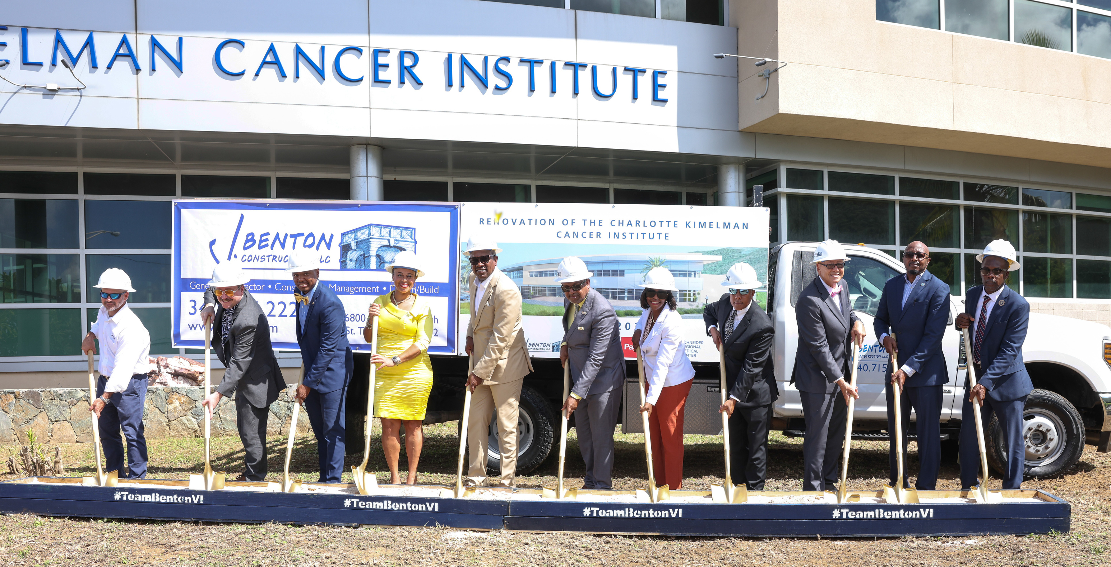



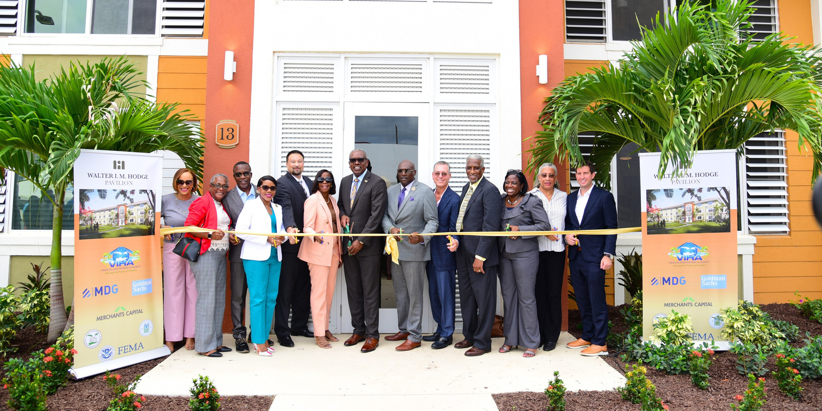
US VIRGIN ISLANDS
OFFICE OF DISASTER RECOVERY
Groundbreaking - Charlotte Kimelman Cancer Institute
REVENUE
ESTIMATING CONFERENCE
2024
Adrienne L. Williams-Octalien
Director
Ribbon Cutting - Phase I - Walter IM Hodge

Slide 2
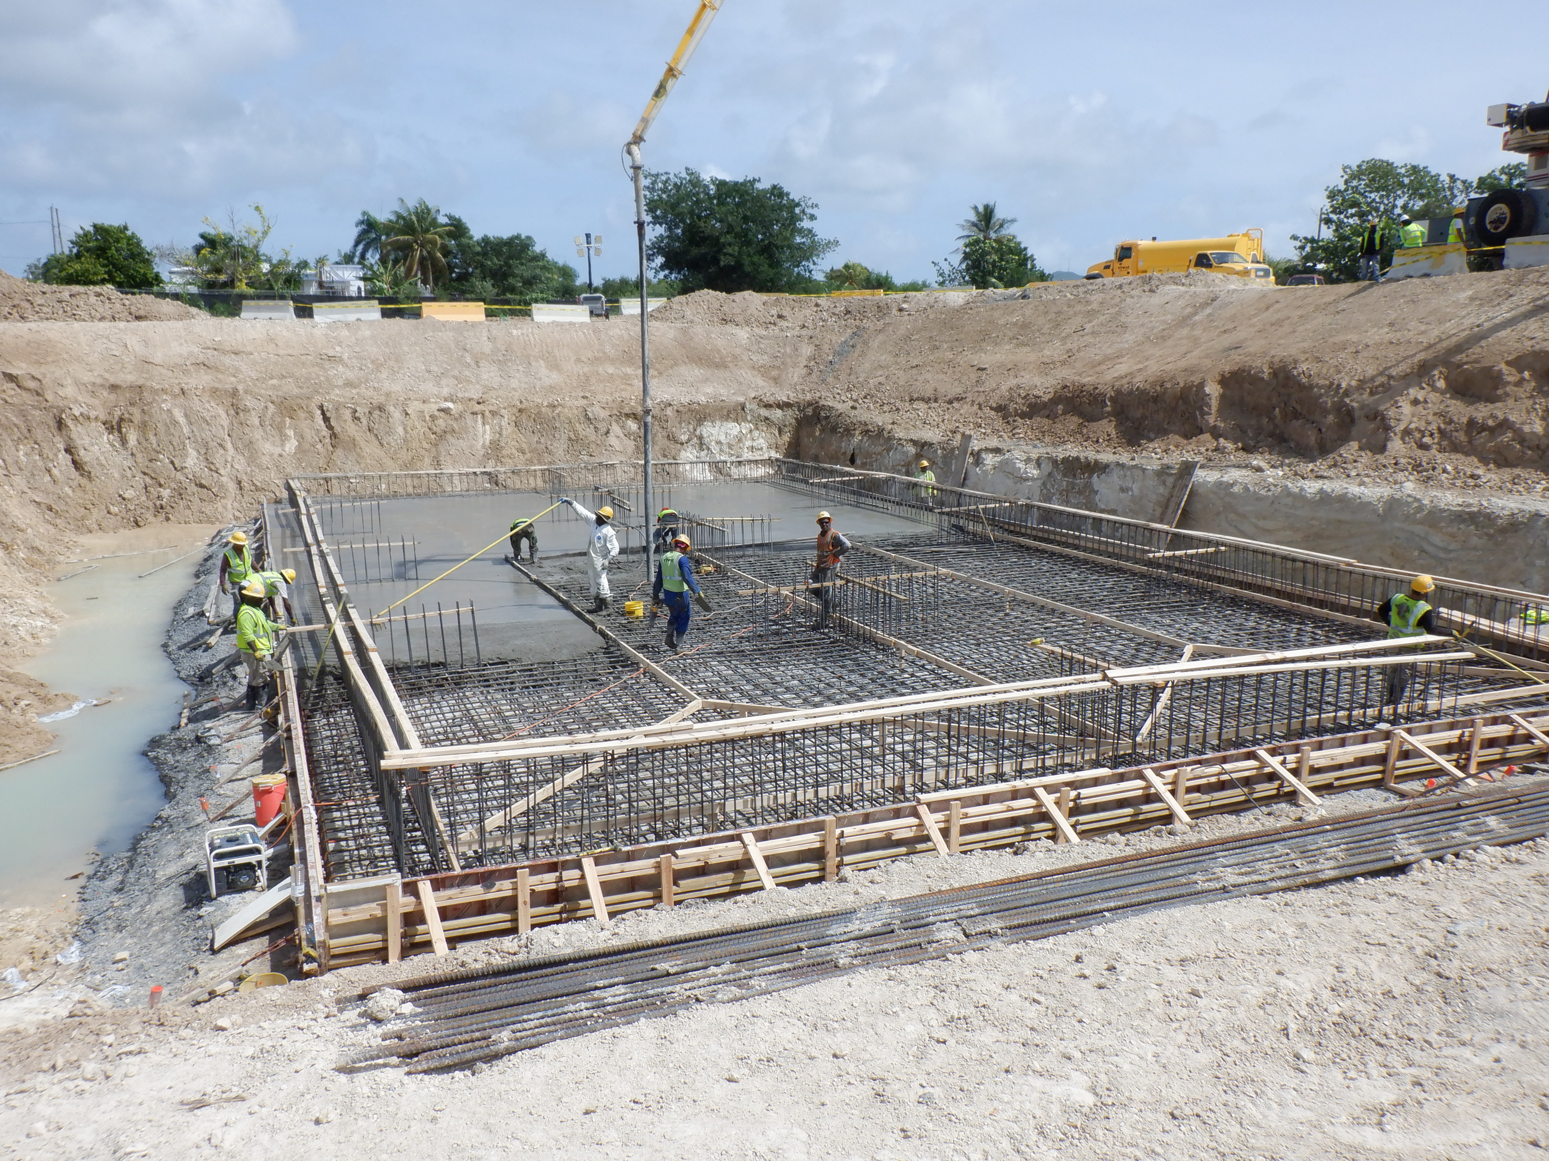



US VIRGIN ISLANDS
VISION, MISSION & STRATEGIC PRIORITIES
Vision
To build a resilient Virgin Islands.
Mission
To build a safe, resilient community that transforms and strengthens the Territory’s infrastructure by building robust systems, cultivating stakeholder collaboration and completing recovery projects to better position the community to thrive.
Strategic
Priorities
Core
Values
Get the Funds
Spend the Funds
Spend the Funds Correctly
  Solutions-oriented
  Transparent
  Accountable
  Committed
  Team-oriented
  Progressive
Secure the maximum amount of disaster recovery funds required for the Territory to rebuild resiliently.
Commence and conclude projects within the required timeframe to guarantee timely processing of Disaster Recovery funds.
Ensure projects executed meet all applicable programmatic and regulatory requirements and internal audits are conducted.

Slide 3
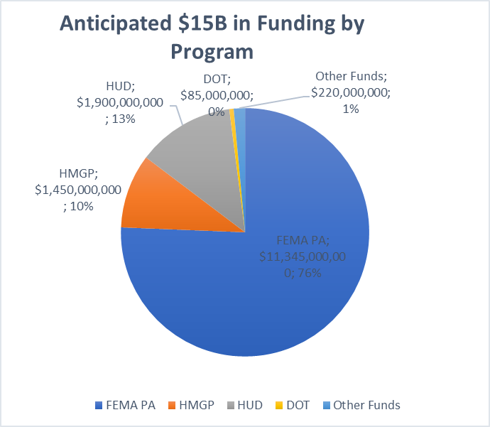
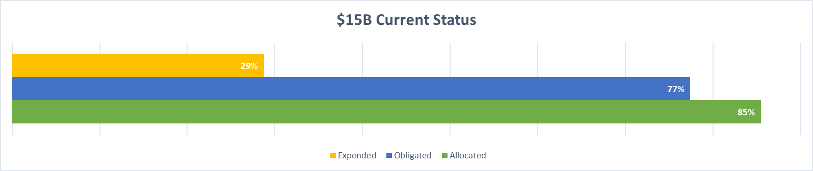
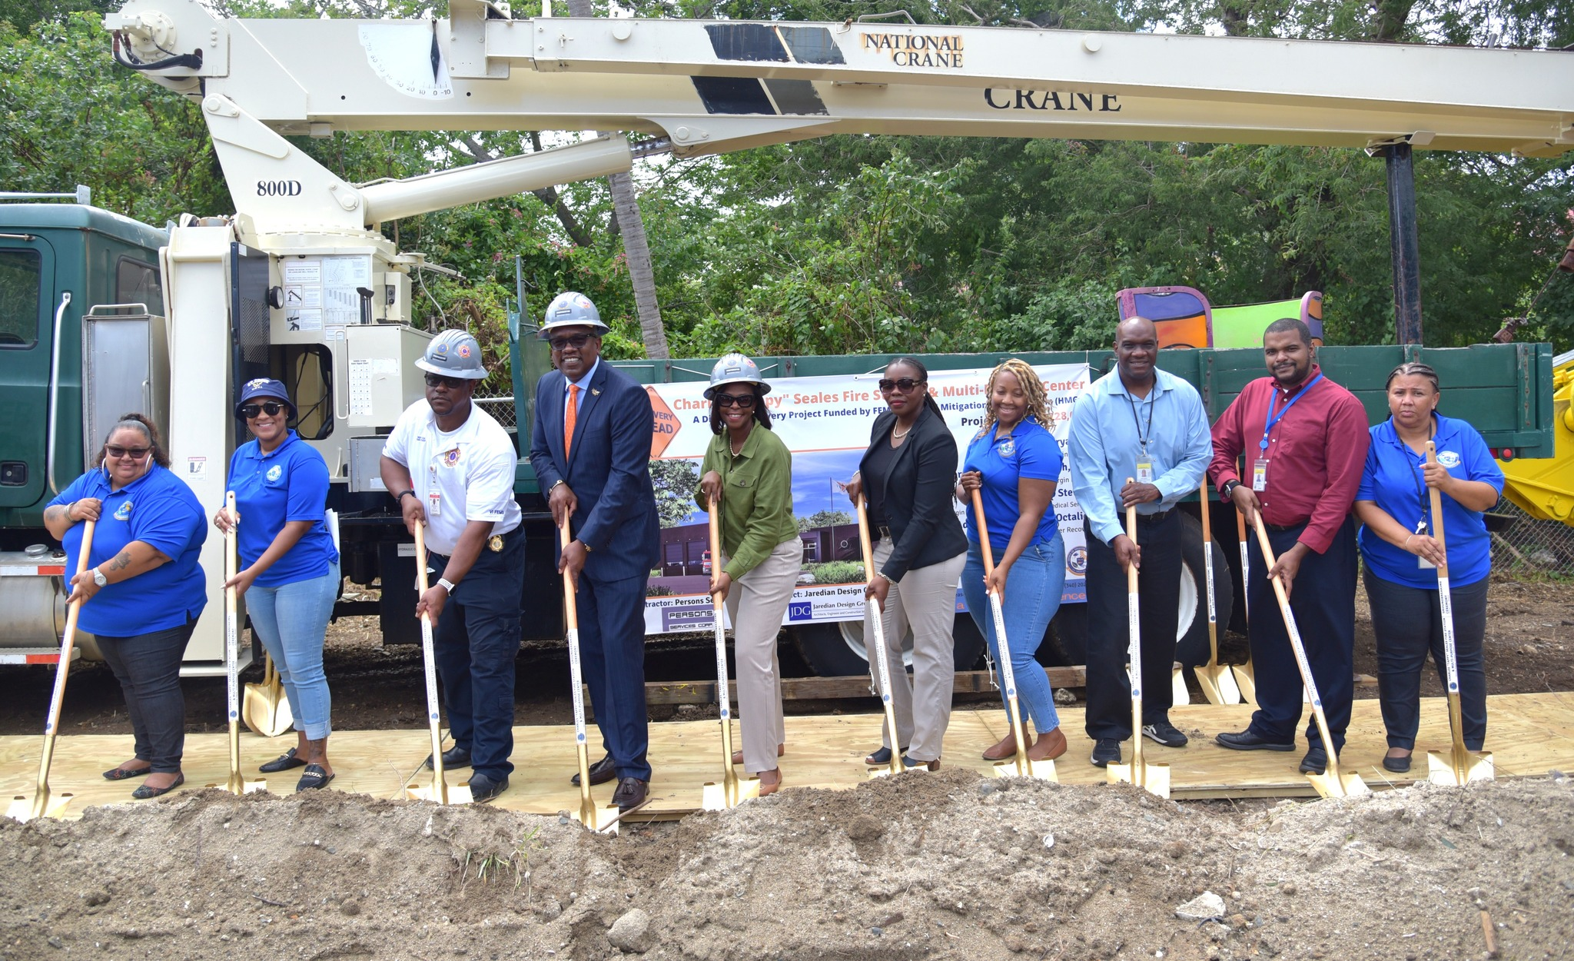
Disaster Recovery
Funding Snapshot
Funding Sources | Anticipated (Estimates) | Allocated | Obligated | Expended | % of Obligated Funds Expended
FEMA PA | $11,345,000,000 | $9,992,882,600 | $9,992,882,600* | $2,719,024,021 | 27.2%
HMGP | $1,450,000,000 | $1,384,484,648 | $188,801,088 | $38,085,010 | 22.8%
HUD | $1,900,000,000 | $1,917,330,884 | $1,917,124,069 | $301,479,875 | 16.3%
DOT | $85,000,000 | $80,536,756 | $68,076,036 | $55,451,523 | 89.2%
Other Funds | $220,000,000 | $208,639,216 | $208,639,216 | $128,325,051 | 67.6%
TOTAL | $15,000,000,000 | $13,583,874,104 | $12,375,523,010 | $3,341,309,656
Data as of March 2024
* Includes Significant Obligations in April

Slide 4
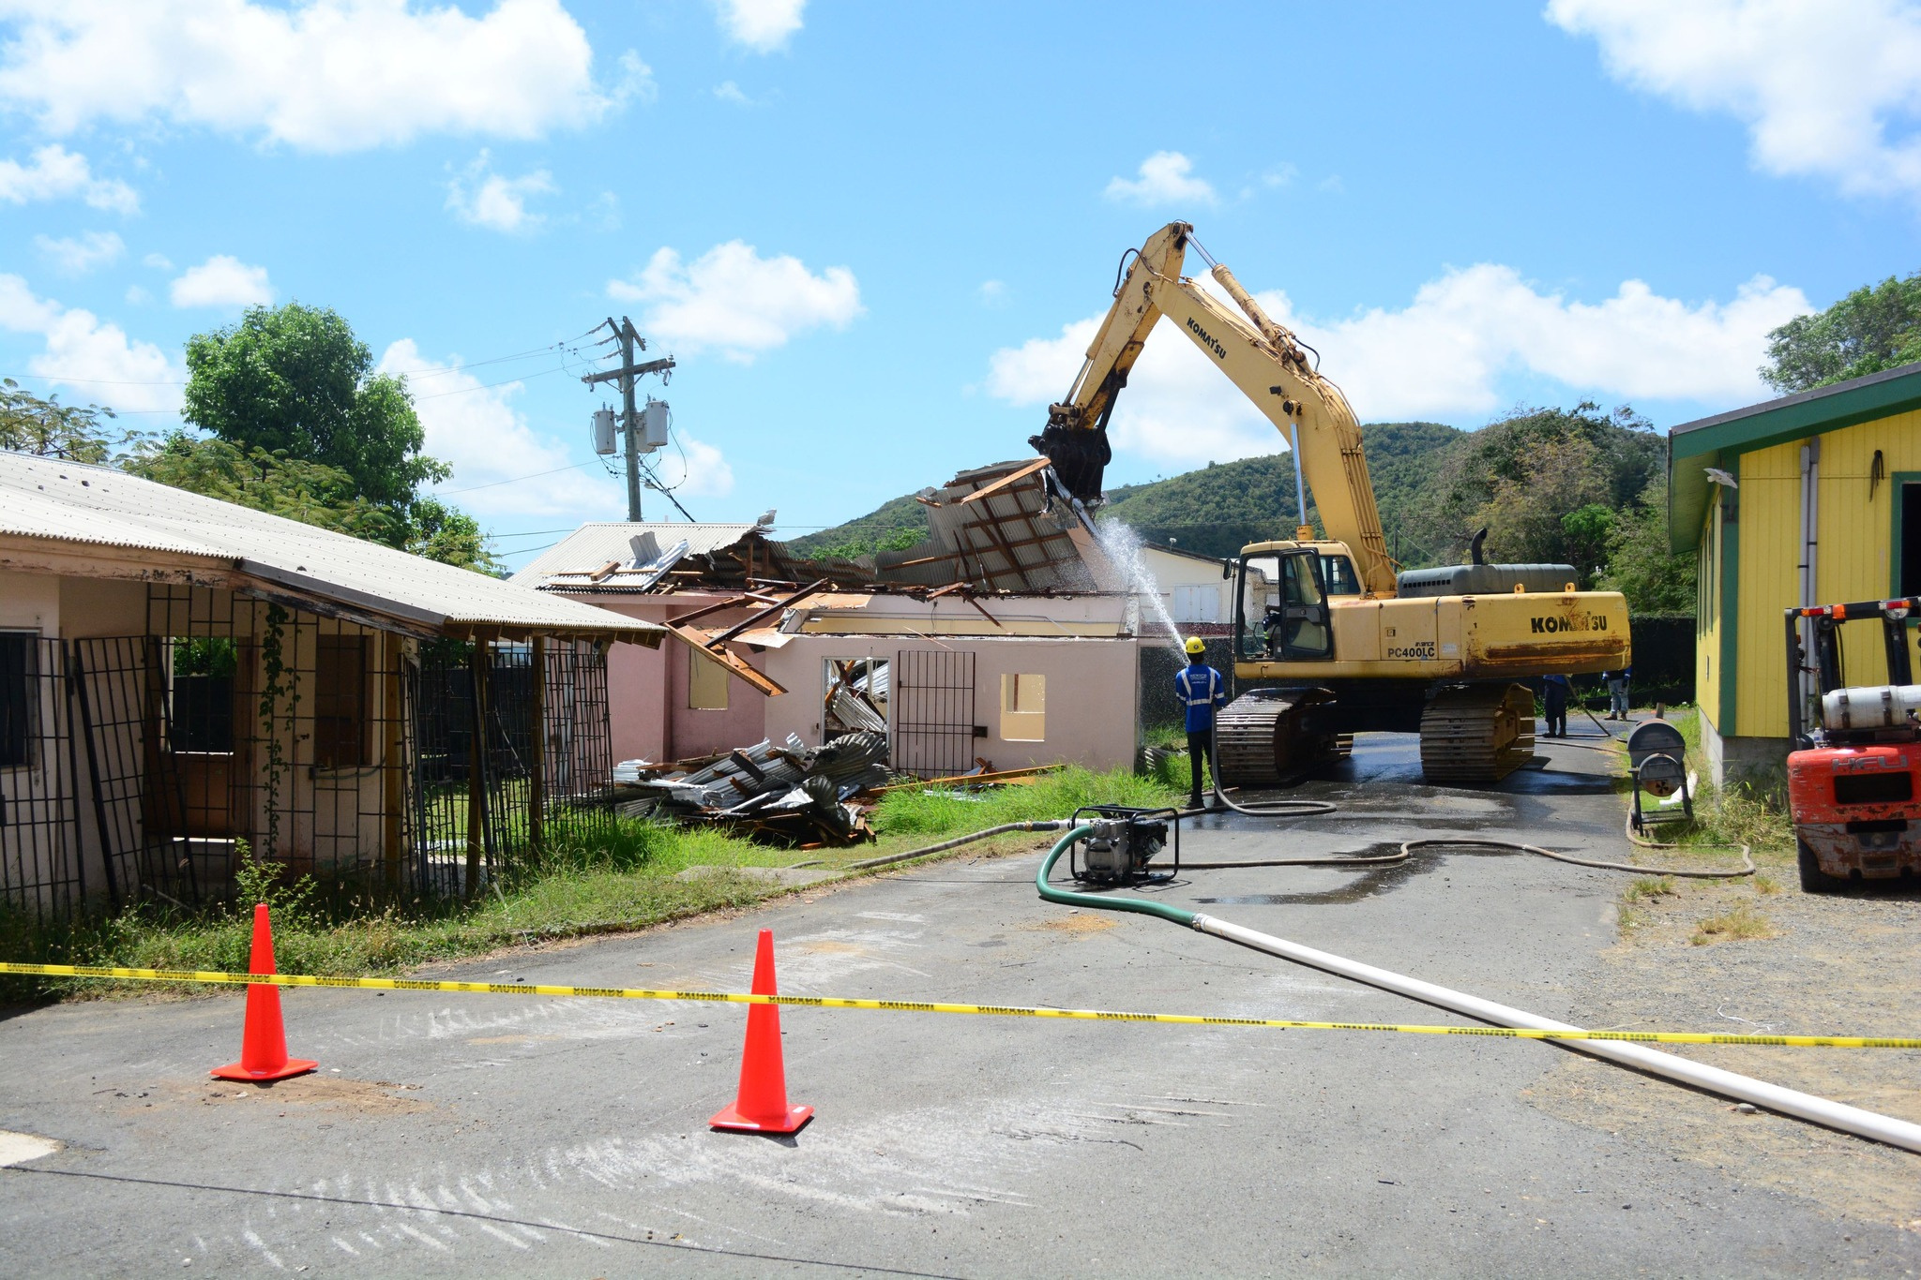
Revenue Estimation
Assumptions
The U.S. Virgin Islands will collect tax revenues from funded disaster projects based on the contractor’s gross receipts.
FY2025 budgeted revenue projections are based on disaster related capital projects (>$500k) that are both currently obligated and those that are expected to be obligated through FY25 across main funding sources.
Over 180 obligated and soon to be obligated projects valued at over $7.0B are expected to impact the FY25 budgeted revenue projections with expected expenditures of $474M in FY25.
Recovery projects also impact other forms of revenue such as licenses, permits, fees, housing, and spend within the community and economy, that is not included in this analysis.

Slide 5
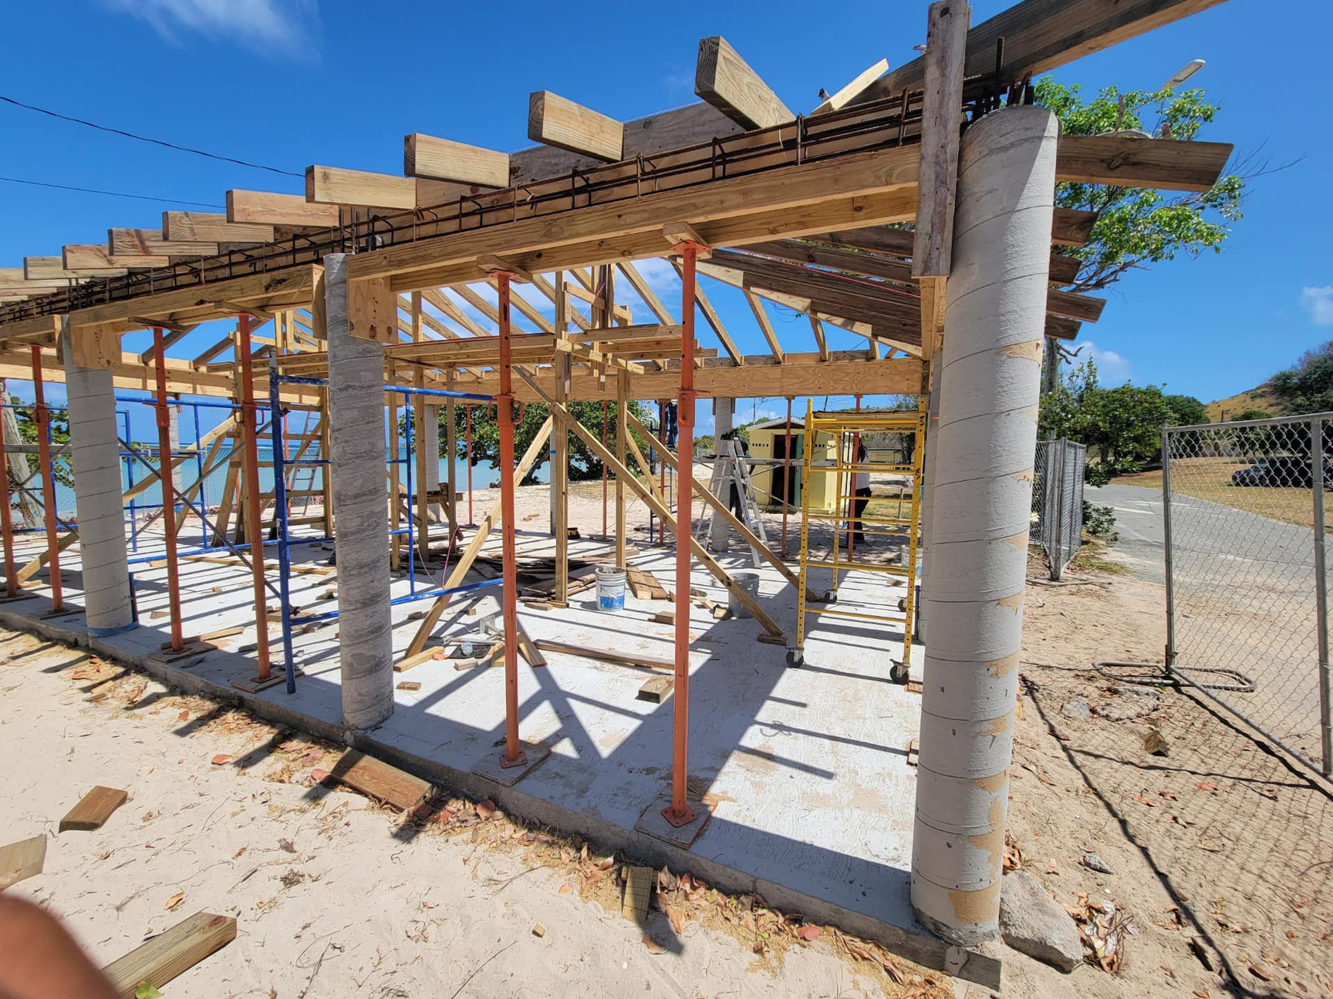
Revenue Performance
Actuals through FY 2024 - Q2
Funding Source​ | FY2024 Expenditure Projection | FY 2024 Expenditure Actuals | FY 2024 GRT Projection | FY 2024 GRT Actual
PA​ | $ 154,563,994 | $ 135,081,001 | $ 7,728,199 | $ 5,231,274
HMGP​ | $ 12,503,764 | $ 8,568,259 | $ 625,188 | $ 174,385
CDBG-DR​ | $ 25,100,504 | $ 15,052,735 | $ 1,255,025​ | $ 752,636
Other Funds​ | $ 17,529,636 | $ 14,616,785 | $ 876,460 | $ 730,839
FHWA-ER​ | $ 2,495,636​ | $ 8,029,965 ​ | $ 124,781 ​ | $ 401,498
TOTAL​ | $ 212,193,098 | $ 181,348,747 | $ 10,609,654 | $ 7,290,634

Slide 6
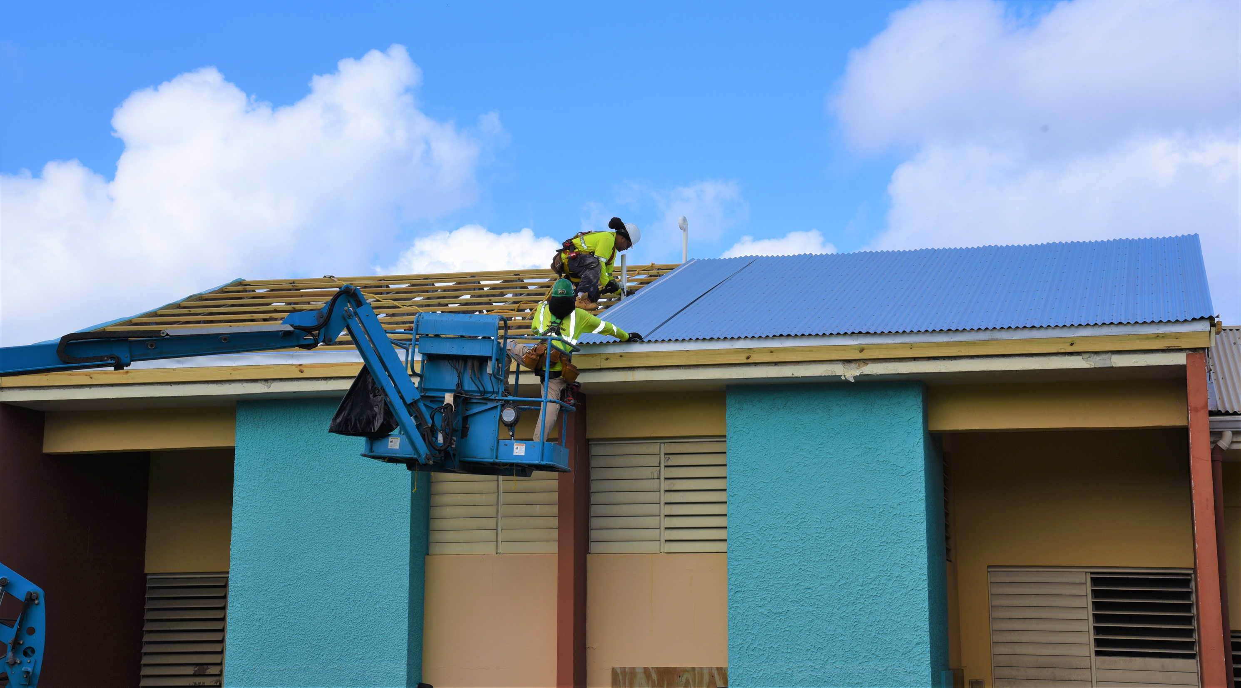

Expenditure
Projections
FY 2025
Revenue Summary
Significant Recovery Projects
Funding Source​ | FY 2025 Projections ​
PA​ | $ 419,225,152
HMGP​ | $ 20,858,672
CDBG-DR​ | $ 32,196,322
Other Funds​ | $ 2,197,820
TOTAL​ | $ 474,477,966
Housing
  EnVIsion Tomorrow
  Infrastructure
  VIWAPA Undergrounding Projects
Health & Human Services
  Charlotte Kimelman Cancer Center
  Charles Harwood Medical Complex
Public Buildings
  Charles Seales Fire Station
  Estate Profit Community Center
Schools
  Arthur Richards PK-8 School
  CAHS Demolition
  Bertha C Boschulte School
  Central High School

Slide 7
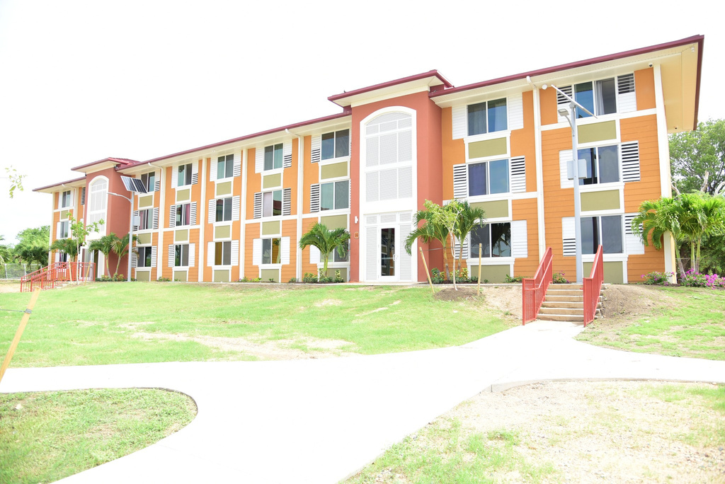
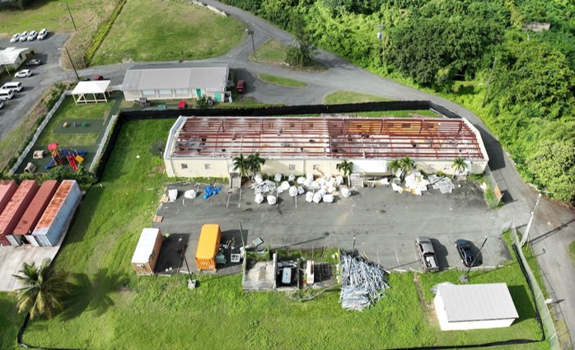
Revenue
Estimating
Snapshot
Revenue Breakdown
FY2025
Total Estimated Revenue
Revenue Category ​ | GRT FY 2024 Projections​
PA​ | $ 20,961,258
HMGP​ | $ 1,042,934
CDBG-DR​ | $ 1,609,816
Other Funds​ | $ 109,891
TOTAL​ | $ 23,723,898
FY25​ | $ 23,723,898
Demo - DHS Anna’s Hope Complex

Slide 8










Office of Disaster Recovery
Communications
Let’s Get Connected
Follow
Website
Youtube
www.usviodr.com
@USVIODR
US NOW
Facebook
Twitter X
@ODRUSVI
@USVIODR
Instagram
LinkedIn
@USVIODR
@USVIODR

Slide 9
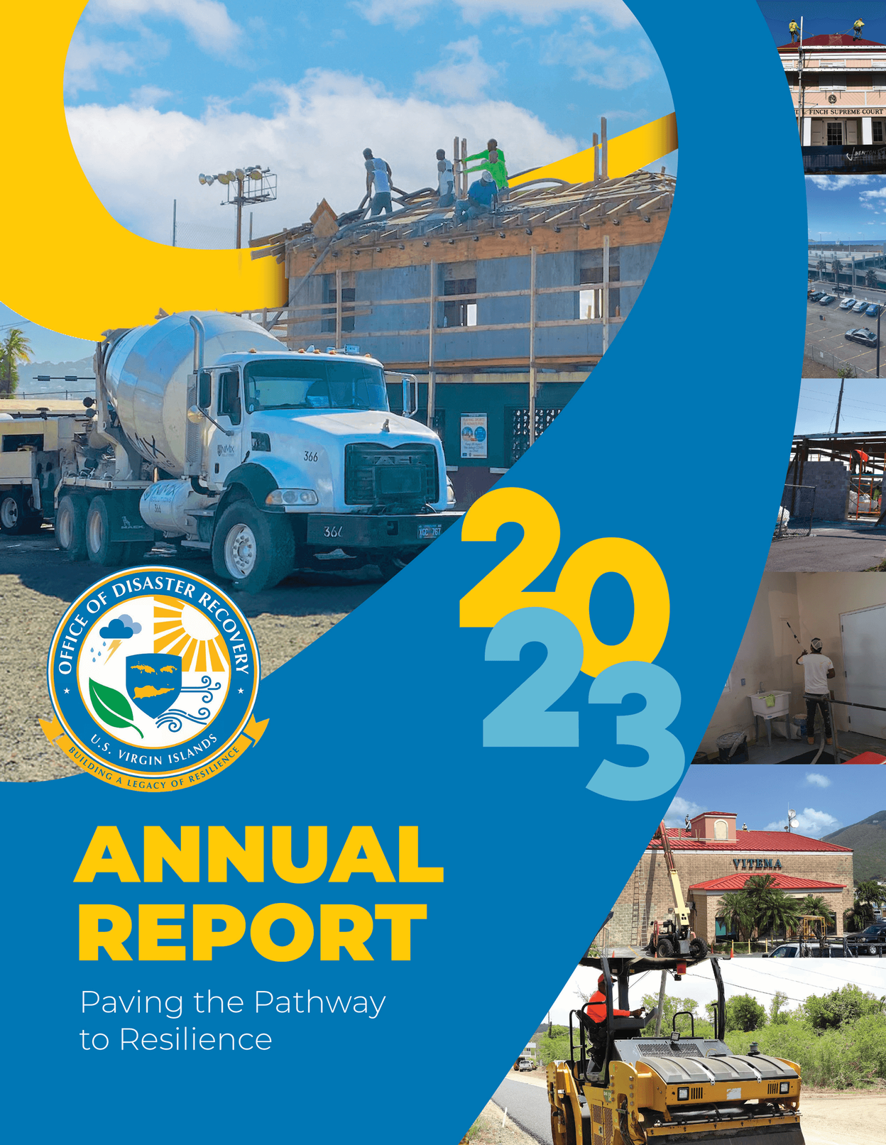


THANK YOU
ANY
QUESTIONS
Contact:
Adrienne L. Williams-Octalien
Director of the Office of Disaster Recovery &
Governor’s Authorized Representative (GAR)
Phone: (340)220-1221
Email: info@usviodr.com

