Slide 1
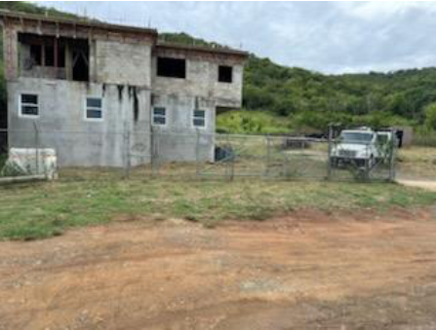
CCZP0158-24: Photo of current site condition- two-story residence under construction

Slide 2
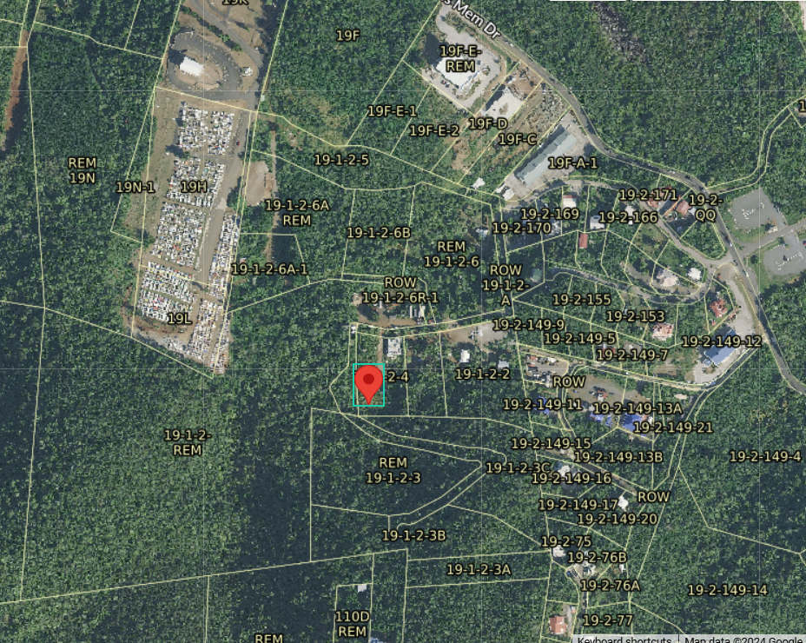
CCZP0158-24: MapGeo aerial view of property (marked in red)

Slide 3
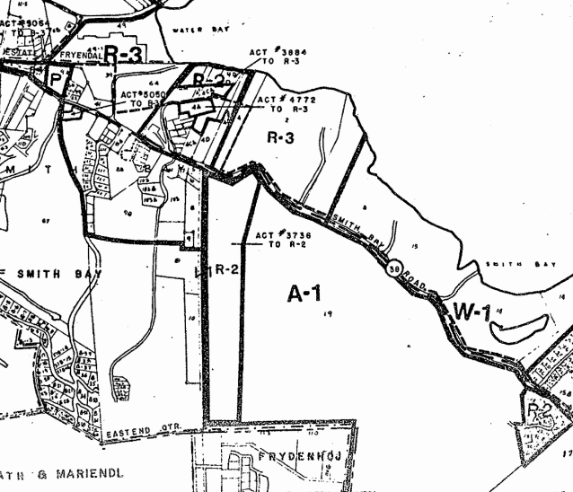

CCZP0158-24: Official Zoning Map No. STZ-9 (property location indicated by red X

Slide 4
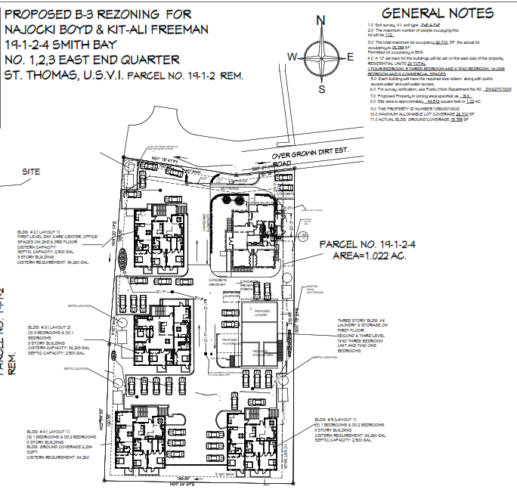
CCZP0158-24: Conceptual Site Plan Layout

