Slide 1

Government of the Virgin Islands
Fall Revenue Estimating Conference
Friday, March 25, 2022
Department of Planning & Natural Resources
Jean-Pierre L. Oriol
Commissioner
Notes:
Good morning Governor Bryan, good morning Director O’Neal and my fellow cabinet members, good morning Senators and to all the attendees present in person and following us via the live stream, my name is….

Slide 2

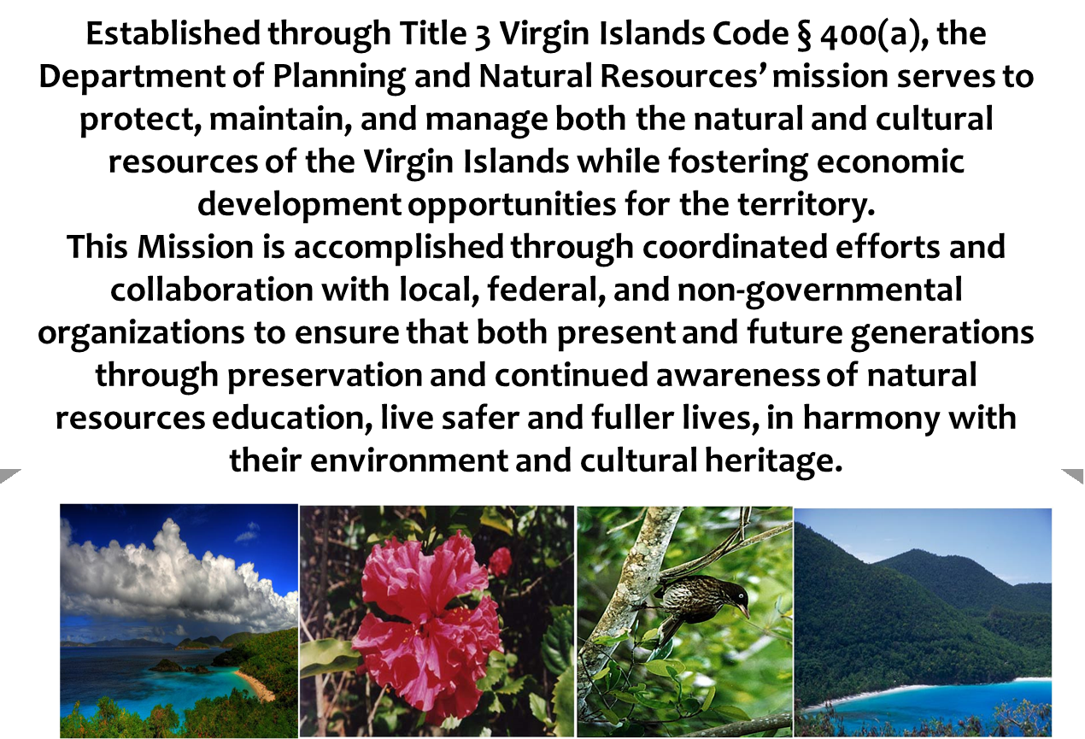
MISSION STATEMENT
Notes:
DPNR is the resource management or regulatory agency of the GVI that ensures the protection of our natural, cultural and historic resources. Our mission is to balance the protection of these resources, while fostering economic activity. Our six regulatory programs institute application and permit procedures for compliance with federal and territorial air, water, flood, building, endangered and historic resources.

Slide 3
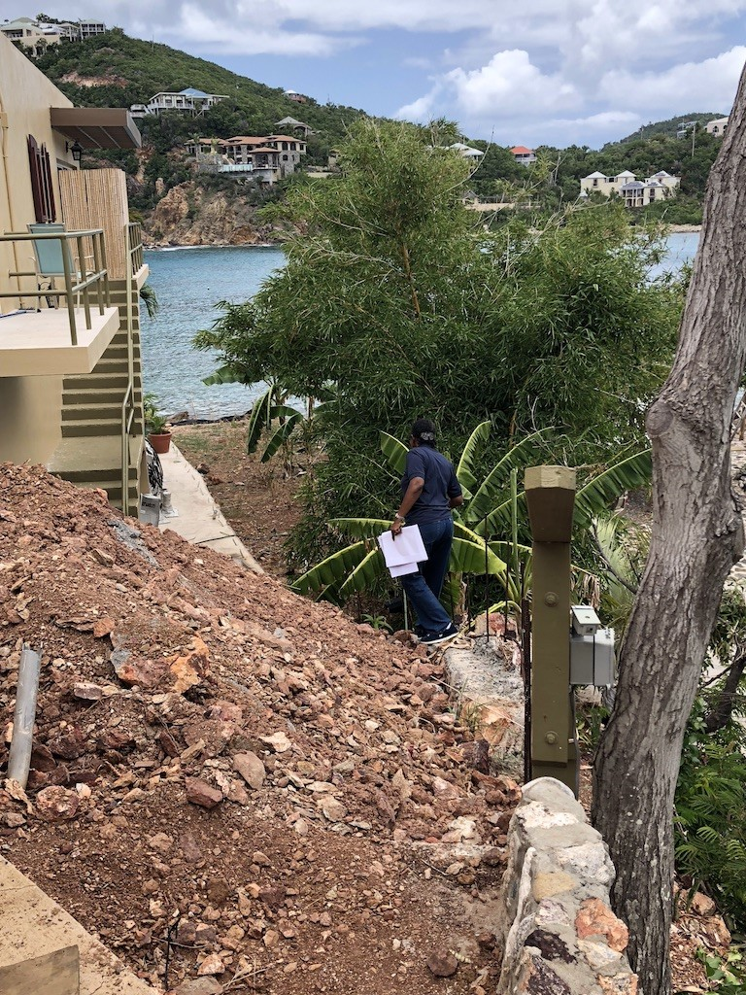
DPNR COLLECTIONS
DPNR collections are done primarily through the collection of fees for permitting, inspections, leasing and registrations
Collections are earmarked for both General Fund and number of Special Funds
Total Collections combined average between $6 Million and $7 Million per year
($6.4M in FY 2021, $6.9M in FY 2022, and $6.6M anticipated in 2023 and $6.7M in FY 2024)
Notes:
Collected a combined total of $6,430,879 ($2,542,058.87 GF; $3,888.819.92 SF) in FY’21; we anticipated an additional $500k in collections for FY 2022

Slide 4
SESSION: General Fund
Fiscal Years 2021 - 2024
Categories | FY2021 Actuals | FY2022 Estimated | FY 2022 Actuals | FY2023 | FY2024
Demolition Permits | $ 36,619.51 | $ 18,513.74 | $ 7,714.06 | $ 24,477.25 | $ 26,536.83
Building Permits | $ 2,065,530.14 | $ 2,013,901.51 | $ 839,125.63 | $ 1,934,393.03 | $ 2,004,608.23
Sign Permits | $ 11,507.14 | $ 4,264.89 | $ - | $ 5,666.52 | $ 7,146.18
Electrical Permits | $ 239,781.58 | $ 127,429.13 | $ 53,095.47 | $ 202,922.22 | $ 190,044.31
Sanitary Permits | $ 3,198.67 | $ 112,213.61 | $ 46,755.67 | $ 133,490.50 | $ 106,300.93
Earth Change Permits | $ 70,926.32 | $ 56,305.39 | $ 23,460.58 | $ 58,521.30 | $ 61,917.67
Occupancy Permits | $ 19,814.00 | $ 19,894.56 | $ 8,289.40 | $ 20,131.52 | $ 19,946.69
Flood Permits | $ 18,027.15 | $ 14,456.06 | $ 6,023.26 | $ 14,959.41 | $ 15,814.21
Over Collection | $ 13.00 | $ 100.80 | $ 42.00 | $ 69.00 | $ 60.93
Mechanical Fees | $ 1,709.00 | $ 14,065.03 | $ 5,860.43 | $ 13,673.34 | $ 9,815.79
Penalty on Return Check | $ 171.86 | $ 177.60 | $ 74.00 | $ 229.63 | $ 193.03
Violation Fines | $ 1,500.00 | $ 750.00 | $ - | $ 750.00 | $ 1,000.00
Photocopies | $ 19.50 | $ 19.75 | $ - | $ 19.75 | $ 19.67
Placard Fees | $ 3,241.00 | $ 2,656.80 | $ 1,107.00 | $ 3,055.93 | $ 2,984.58
Total | $ 2,542,058.87 | $ 2,384,748.88 | $ 991,547.60 | $ 2,412,359.41 | $ 2,446,389.05
Notes:
General Fund collections are exclusively from our Permits division. For FY 2022 we decided to decrease our overall expectations on collections from FY 2021 as we follow closely the execution of the EnVision Tomorrow program through VIHFA. We are pleased to see that contracts to execute repairs are in place, but this has not yet yielded a significant amount of applications to date.

Slide 5
SPECIAL FUNDS
Fiscal Years 2021 - 2024
Notes:
Next several slides provide an overview of the various special funds associated with the execution of the mandates of the Department.

Slide 6
Special Funds Categories
FUND | FY2021 Actuals | FY2022 | FY2022 Actuals | FY2023 | FY2024
Air Pollution Control (Title V) | $ 152,768.00 | $ 41,376.84 | $ 17,240.35 | $ 132,770.28 | $ 108,971.71
VI Coastal Protection | $ 158,750.50 | $ 246,640.13 | $ 85,454.89 | $ 167,960.38 | $ 191,117.00
Underground Storage Tank | $ 24,000.00 | $ 6,000.00 | $ 2,500.00 | $ 15,166.67 | $ 15,055.56
Fish and Game | $ 361,738.09 | $ 364,592.93 | $ 83,446.44 | $ 352,925.03 | $ 359,752.01
Legal Publications Revolving | $ 6,206.00 | $ 6,564.27 | $ 2,734.00 | $ 5,743.35 | $ 6,171.21
Libraries & Museum Revolving | $ 39,310.00 | $ 51,352.80 | $ 21,397.00 | $ 46,318.47 | $ 45,660.42
Program Income | $ 45,514.00 | $ 50,546.40 | $ 21,061.00 | $ 41,009.97 | $ 45,690.12
Natural Resources Reclamation | $ 3,100,533.33 | $ 3,813,016.95 | $ 1,798,097.49 | $ 3,799,247.53 | $ 3,570,932.60
Total | $ 3,888,819.92 | $ 4,580,090.31 | $ 2,031,931.17 | $ 4,561,141.66 | $ 4,343,350.63
Notes:
We have 8 Special funds specific to the department's operations. Our largest source, the Natural Resources Reclamation Fund, is the main driver of our collections, primarily through the management of our submerged and filled submerged land leases

Slide 7
Virgin Islands Coastal Protection Fund
Categories | FY2021 Actuals | FY2022 | FY2022 Actuals | FY2023 | FY2024
Pesticide Applications | $ 195.00 | $ 180.00 | $ 75.00 | $ 185.00 | $ 186.67
Air Pollution | $ 8,471.00 | $ 21,000.00 | $ 8,750.00 | $ 12,942.33 | $ 14,137.78
Well Permits/License | $ 1,170.00 | $ 1,932.00 | $ 805.00 | $ 1,410.67 | $ 1,504.22
Terminal Facilities | $ 54,400.00 | $ 88,800.00 | $ 37,000.00 | $ 69,616.67 | $ 70,938.89
Photocopies | $ 378.50 | $ 1,696.80 | $ 707.00 | $ 706.60 | $ 927.30
Notice of Violations | $ 100.00 | $ 24,000.00 | $ 10,600.00 | $ 8,086.67 | $ 10,728.89
Soil Boring | $ 1,650.00 | $ 1,368.00 | $ 570.00 | $ 1,376.00 | $ 1,464.67
Ground Water | $ 1,290.00 | $ 408.00 | $ 170.00 | $ 869.33 | $ 855.78
Solid Waste | $ 7,060.00 | $ 5,040.00 | $ 2,100.00 | $ 6,226.67 | $ 6,108.89
Medical Waste | $ 1,410.00 | $ 2,832.00 | $ 1,180.00 | $ 1,487.33 | $ 1,909.78
Water Pollution | $ - | $ 166.67 | $ - | $ 222.22 | $ 129.63
TPDES Permit | $ 82,626.00 | $ 95,000.00 | $ 23,497.89 | $ 105,000.00 | $ 94,208.66
Laboratory Certificate | $ - | $ 4,216.67 | $ - | $ 5,622.22 | $ 3,279.63
Total | $ 158,750.50 | $ 246,640.13 | $ 85,854.89 | $ 213,751.71 | $ 206,380.78
Notes:
Coastal Protection is our largest opportunity for increased collection. As the refinery comes online, we collect in our air pollution fund; as more of our demolition projects come online, there’s increased collection in our soAs we staff up and can bring more people into compliance with permitting requirements, we will see a larger stream of collections

Slide 8
Fish and Game Fund
Categories | FY2021 Actuals | FY2022 | FY2022 Actuals | FY2023 | FY2024
Boat Registration | $ 326,293.59 | $ 313,439.33 | $ 69,692.44 | $ 313,439.33 | $ 317,724.08
Fishing License | $ 13,138.50 | $ 4,992.00 | $ 2,080.00 | $ 10,149.17 | $ 9,426.56
Fish House Rental | $ 21,734.00 | $ 46,080.00 | $ 11,640.00 | $ 43,968.00 | $ 43,968.00
Miscellaneous | $ 572.00 | $ 81.60 | $ 34.00 | $ 284.53 | $ 312.71
Total | $ 361,738.09 | $ 364,592.93 | $ 83,446.44 | $ 367,841.03 | $ 371,431.35
Notes:
With the LaReine Fish Market re-opened in 2021, we were able to generate about $38k in income; however, the cost to operate the facility is about $33k per year, so not much generation.

Slide 9
Legal Publication Revolving Fund
Categories | FY2021 Actuals | FY2022 | FY2022 Actuals | FY2023 | FY2024
Zoning Amendment | $ 5,385.00 | $ 5,472.00 | $ 2,280.00 | $ 5,101.60 | $ 5,319.53
Sub-Division | $ 813.00 | $ 1,089.60 | $ 454,.00 | $ 638.20 | $ 846.93
Copies | $ 8.00 | $ 2.67 | $ - | $ 3.56 | $ 4.74
Total | $ 6,206.00 | $ 6,564.27 | $ 2,734.00 | $ 5,743.35 | $ 6,171.21
Notes:
Not much generation from the zoning map amendment requests. Application fees for this are $250

Slide 10
Natural Resources Reclamation Fund
Categories | FY2021 Actuals | FY2022 | FY2022 Actuals | FY2023 | FY2024
Lease | $ 2,598,409.45 | $ 3,161,268.02 | $ 1,618,703.82 | $ 3,258,315.28 | $ 3,005,997.58
Permits | $ 59,590.39 | $ 92,004.82 | $ 38,335.34 | $ 65,565.74 | $ 72,386.98
Mooring | $ 337,535.50 | $ 330,000.00 | $ 45,813.82 | $ 314,385.27 | $ 327,306.92
Anchoring | $ 32,316.45 | $ 38,984.88 | $ 16,243.70 | $ 35,017.64 | $ 35,439.66
Sub Rental | $ 34,359.08 | $ 36,092.88 | $ 15,038.70 | $ 33,550.67 | $ 34,667.54
Historic Preservation | $ 0 | $ 50,365.94 | $ 20,985.81 | $ 16,788.65 | $ 22,384.86
Notice of Violation | $ 600.00 | $ 1,157.29 | $ - | $ 585.76 | $ 781.02
Miscellaneous Fees | $ 37,722.46 | $ 103,143.12 | $ 42,976.30 | $ 75,038.53 | $ 71,968.04
Total | $ 3,100,533.33 | $ 3,813,016.95 | $ 1,798,097.49 | $ 3,799,247.53 | $ 3,570,932.60

Slide 11
SESSION: Upcoming Projects
We have hired a contractor, Online Mooring, to provide a web-based registration and collection system for the collection of mooring and anchoring fees. The system will go live within the next thirty (30) days. We are also introducing a new "Cruising Permit" which will collect $20/foot/month for commercial vessels not registered in the Territory but doing business in the peak visitor season.
The Department is in the process of finalizing new regulations requiring the registration of pesticides in the Territory. Applicants registering their products will be required to pay a licensing fee. The Department estimates new revenue between $75,000 and $85,000 being generated after the promulgation of the new regulations.

Slide 12
SESSION: Upcoming Projects
The Department will be closely monitoring the oil refining plans for West Indies Petroleum. The resumption of refining could generate as much as $300,000 to the Title V fund, based on refining of 280k barrels/year
Lastly, the EnVision Tomorrow program will also provide an uptick in permitting fees. 108 applications have been processed thus far, and we currently have 23 in queue. Every $100k in ECR, results in about $500 towards permitting fees.

Slide 13
SESSION: General Fund
Fiscal Years 2020 - 2024
Categories | FY2021 Actuals | FY2022 | FY2022 Actuals | FY2023 | FY2024
General Fund | $2,542,059 | $2,384,749 | $ 991,548 | $2,412,359 | $2,446,389
Special Funds | $ 3,888,820 | $4,580,090 | $2,031,331 | $4,561,142 | $4,343,351
Total | $6,430,879 | $6,964,839 | $3,023,479 | $6,973,501 | $6,789,740
Notes:
In closing, we did project a slight increase in collections for FY 2022 compared to FY 2021; however, we are looking more like we will match collections from FY 2021.

Slide 14
QUESTIONS
End of Session

