Slide 1
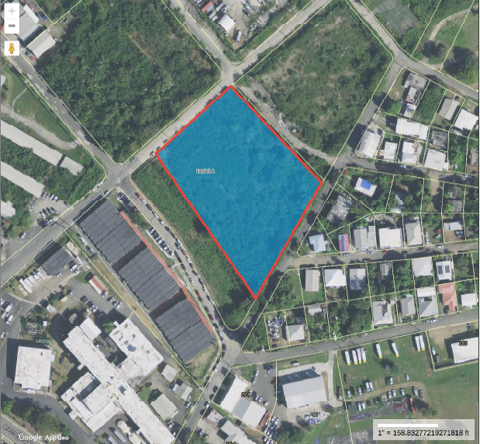
CCZP0008-25: Aerial photo of site, formerly the Ralph de Chabert Housing Project.

Slide 2
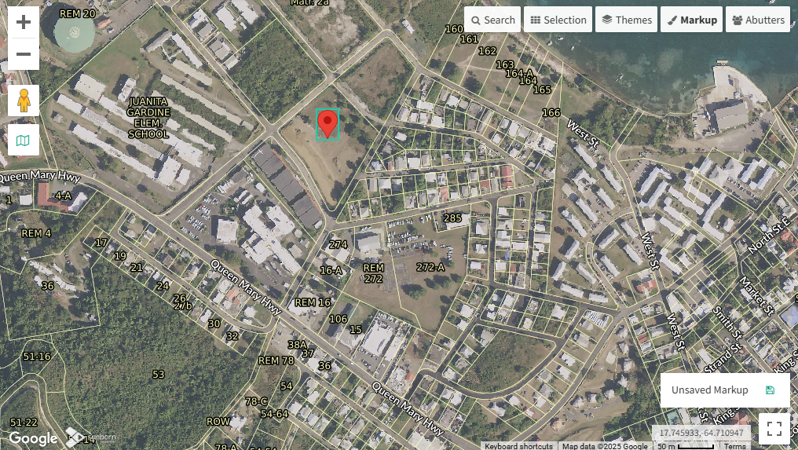
CCZP0008-25: MapGeo aerial view of property (marked in red)

Slide 3
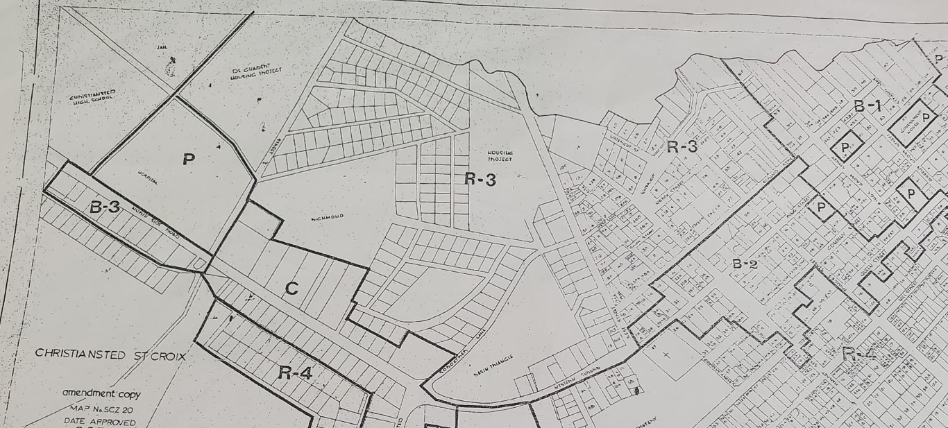

CCZP0008-25: Official Zoning Map No. SCZ-20 (property location indicated by red X)

Slide 4
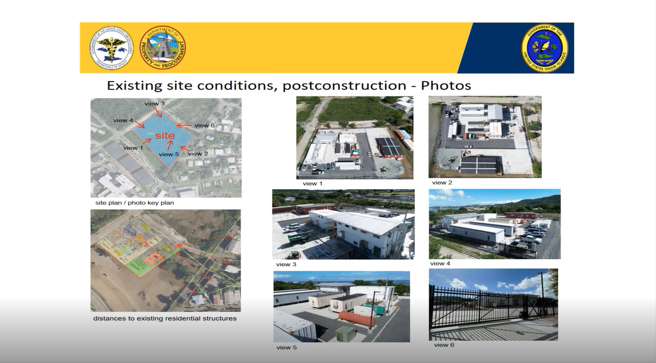
CCZP0008-25:

