Slide 1
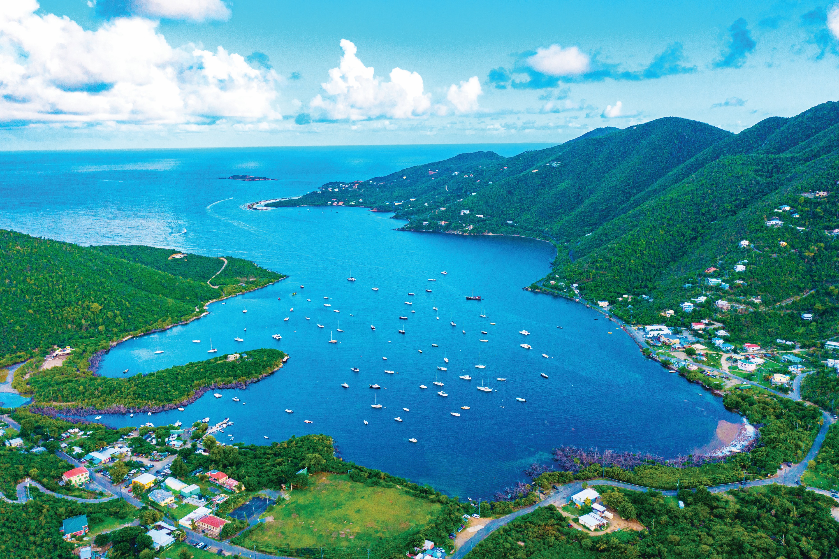


Community Meeting
May 15, 2025

Slide 2



Meeting Agenda
Introductions
Project Overview ​
Committees​
  Role​
  Meeting format​
2040 Plan ​Summary and Project Status
2050 Plan Visioning​
Next Steps
Notes:
Marie- Elsie – Over the next hour, we will provide READ SLIDE

Slide 3



Introductions
Project Team
Mr. Derek Gabriel, Commissioner
Ms. Karole Ovesen-McGregor, Deputy Commissioner
Mr. Jomo McClean, Highway Program Manager
Mr. Piotr Gajewski,
Mrs. Kinila Callendar, Chief of Staff
Ms. Bernadette Melendez, Transportation Planner
Marie-Elsie Dowell, PE, Project Manager​
Maya Miller, Deputy Project Manager​
Mikki Taylor-Hendrix, Public Engagement​
Derrice Ezzell, Transportation Planning
Community Advisory Group
Name
Department/ Organization
Island(s) Represented
Role (if applicable)
Notes:
Marie-Elsie – On behalf of the USVI Department of Public Work (DPW), we welcome you to the first Executive Committee Meeting for development of the 2050 Comprehensive Master Transportation Plan.

Slide 4
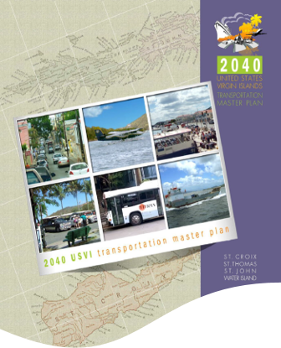
Project Overview
Build on the 2040 Plan’s foundation ​
Update data to reflect current conditions
Implement an extensive public involvement program
Outline strategies to improve transportation infrastructure through 2050
Identify projects to address future transportation needs
Notes:
Marie-Elsie - Close to 10 years ago, DPW developed the 20240 Comprehensive Master Plan and this project is to READ THE SLIDE. The 2050 Plan will look at all modes of transportation within the entire Territory including interisland transportation.

Slide 5

Project Overview - Public Engagement Strategy
Engagement Process
Engagement Materials
Public Meetings
Project information Presentation​
Draft Project Results​
Final Project Results
Public Meetings (3)
Meeting Flyers
Emails
Facebook Posts
Local Media outlets
DPW website
Notes:
Mikki - The 2050 Plan can only be successful if it represents the desires of the community and addresses issues and needs identified by the community. It is therefore crucial that the plan be based on an extensive public engagement program and uses strategies to engage the public. READ SLIDE.

Slide 6



Committees
Executive Committee
Oversee the Study
Technical Committee
Provide input on the technical aspects of the study
Community Advisory Committee
Participate through public meetings, help promote the study through their networks
Provide input to reflect community perspective
Notes:
Mikki - A major component of the strategy is establishing three committees that will drive the plan.

Slide 7

Technical Committee
Role
The purpose of the technical committee
Provide insight and direction on technical aspects.
Meeting Format
The Technical Committee will continue to be engaged throughout the project by email and at least one to two future meetings.
Notes:
Marie –Elsie – As the Executive Committee your role is crucial in driving the process in confirming the goals and objectives, identify transportation issues and solutions as well as establishing policies to drive the implementation of the plan. READ SLIDE on Meeting Format.

Slide 8
Technical Committee
Role
The purpose of the technical committee
Provide insight and direction on technical aspects.
Meeting Format
The Technical Committee will continue to be engaged throughout the project by email and at least one to two future meetings.
Notes:
Marie –Elsie – The Technical Committee's role INCLUDE FROM SCOPE. READ SLIDE on Meeting Format.

Slide 9
Community Advisory Committee
Role
Community Advisory Groups (CAG), consisting of representatives of business, cultural, homeowners and social service Organizations and will make sure these interests are reflected in the plan and future projects.
Meeting Format
Two meetings will be scheduled. One at the beginning of the project and the second at midpoint, project updates will be shared as needed.
Notes:
Marie –Elsie –The Community Advisory Committee INCLUDE DESCRIPTION FROM SCOPE. READ SLIDE on Meeting Format.

Slide 10




Committees Timeline
Fall 2025
Spring 2025
Summer 2025
Winter 2025/2026
Executive Committee
Technical Committee
Public Meetings
Executive Committee
Technical Committee
Executive Committee
Technical Committee
Public Meetings
Executive Committee
Technical Committee
Notes:
Marie-Elsoe

Slide 11
2040 Plan Summary
  Established Goals and Vision
  Identified short- and long-term transportation needs.
  Established performance measures focused on:
    Inventory of the existing transportation system.
    Improving roadway efficiency, safety, and effectiveness.
    Ensuring long-term maintenance.
  Recommended strategies to enhance the USVI’s public transit system.
First Comprehensive Transportation Master Plan (CTMP) for the U.S. Virgin Islands (USVI)
Notes:
Maya - As the first comprehensive master transportation plan for the Territory, the 2040 plan developed about 10 years ago was instrumental in READ THE SLIDE. Development of a Transportation Master Plan is crucial in developing a short and long-range plan for the Transportation Improvement Program for example. A transportation master plan is also a powerful tool for solicit funding from the federal government for all types of transportation projects.

Slide 12
2040 Projects Status
Notes:
Maya - As a matter of fact, 34 to 43 percent of the projects have been completed.

Slide 13
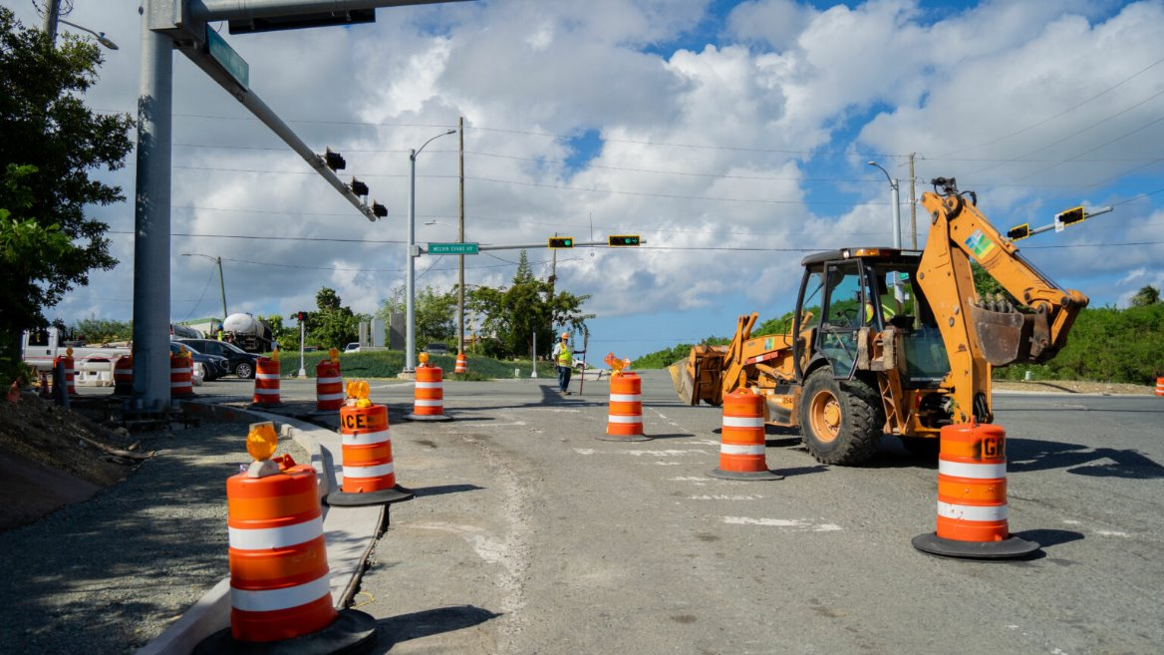
2040 Projects Status - St. Croix
23 Project Identified
10 Completed
Melvin Evans Highway Roadway Improvements​
Notes:
Maya - READ THE SLIDE

Slide 14
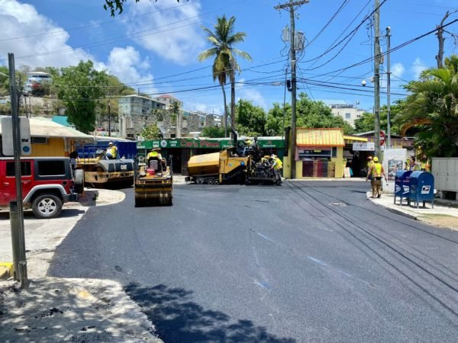
2040 Projects Status - St. John
28 Project Identified
10 Completed
Centerline Road (Rt 10) Roadway Improvements​
Notes:
Maya - READ THE SLIDE

Slide 15
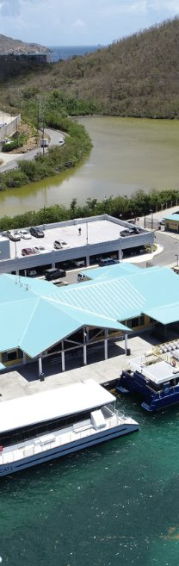
2040 Projects Status - St. Thomas
20 Project Identified
9 Completed
Parking garage at the Urman V. Fredericks Marine Terminal in Red Hook​
Notes:
Maya - READ THE SLIDE

Slide 16
2040 Plans - Goals and Vision
Vision | An integrated transportation system which serves the needs of the USVI community.
-
Goal 1 –Economic Development | Provide an integrated transportation system that grows the economy of the USVI
Goal 2 – Safety and Security | Improve the safety and security on all transportation modes in the Territory through education, enforcement and engineering solutions
Goal 3 – Operation and Maintenance | Maximize the efficiency of existing transportation facilities and services through upgraded facilities and improved management, operations and maintenance activities
Goal 4 - Environmental Sustainability and Land Use | To ensure that the transportation system supports the development of communities that provide transportation choices and preserves the Territory’s natural, historic, and cultural resources.
Goal 5 – Manage Congestion to Optimize Mobility and Accessibility | To maximize mobility and accessibility by strategically managing transportation facilities and services to reduced travel times and levels of congestion
Notes:
Maya - The 2040 established goals and a vision for specific areas from economic development, environmental sustainability, and NEXT SLIDE

Slide 17
2040 Plans – Goals and Vision
Vision | An integrated transportation system which serves the needs of the USVI community.
-
Goal 6 - Provide a Seamless and Integrated Transportation Network | To improve on-island and inter-island accessibility and mobility for people and goods across all modes of transportation; ensure interconnected access to all areas of the Territory, the nation and the world
Goal 7- Agency and Public Outreach in Transportation Planning and Programming | To improve coordination, communication, and cooperation among transportation professionals, users, providers, and those affected by transportation activities, regardless of race, religion, national origin, or income.
Goal 8 - Financial Accountability | To create a transportation funding structure that is stable and reliable and supports a viable transportation system to achieve territorial and local goals now and into the future
How do you feel about these goals?
Notes:
Maya - Seamless and integrated transportation network. These goals and vision have established the foundation on which the government of the USVI was able to not only develop but implement a comprehensive list of improvements since the adoption of the 2040 plans.

Slide 18
What’s Next?
As we plan through 2050, there are a few key questions we’d like your input on.
Notes:
MIKKI - READ THE SLIDE

Slide 19

2050 Plan Visioning
What currently is the key mobility/transportation challenge in the territory? Share your thoughts on the most critical transportation challenges
What drives the need for action in the USVI?
What are the issues we want to solve?
What goals or outcomes are important to your organization?
What are your areas of focus, interest, or concern related to this study?
Your vision for 2050?
Use the maps around the room to give input on what are the focus area for 2050
Notes:
Mikki - Let's lay the foundation of the 2050 plan by gaining some insights from you on all modes of transportation READ THE SLIDE. We will provode you with maps of the islands for providing input on specific projects in the Territory including inter-islands connectivity. These maps will be shared with the community at large during the community meetings this week. The outcome will be discussed at our next meeting.

Slide 20

2050 Plan Visioning – Follow-up Items
Information/data from your organization​
Individuals/organizations to involve in public process including agencies, contacts, champions, skeptics, etc.​
Major events or opportunities for public engagement/input​
Notes:
Mikki - As an Executive Committee, your role of setting policies and driving the direction of the 2050 Comprehensive Transportation Plan, it is crucial to hear from you on READ THE SLIDE.

Slide 21
How to Stay Engaged
Follow the project Facebook Page
  https://www.facebook.com/people/USVI-2050-Transportation-Study/61575780062429/
DPW Website will share updates
Promotions will continue to be shared through local media
Provide your email address to get meeting and update emails from the project team
  Mikki.taylorhendrix@wsp.com
Notes:
Mikki - As an Executive Committee, your role of setting policies and driving the direction of the 2050 Comprehensive Transportation Plan, it is crucial to hear from you on READ THE SLIDE.

Slide 22
Next Steps – Committee Meetings
Technical Committee Meeting 5/13
Public Meetings
5/13-5/15
Existing Conditions Information
Notes:
Maya - READ THE SLIDE

Slide 23
Next Steps - Project Timeline
Spring 2025
Fall 2025
Existing Conditions, Traffic and land use trends
Short range improvements, long range alternatives, draft financial plan updates
Draft Plan Workshop
Final Plan Presentation (if needed)
Summer 2025
Winter 2025/2026
Notes:
Maya - This is the anticipated timeline for the project.

Slide 24


Thank You!
Notes:
Marie-Elsie – We really appreciate your help in laying the foundation of the 2050 Comprehensive Master Plan and we are looking forward to continuing to build a successful plan.

