Slide 1

REVENUE ESTIMATING CONFERENCE
2023 SPRING REVENUE ESTIMATING CONFERENCE
GARY MOLLOY, COMMISSIONER
VIRGIN ISLANDS DEPARTMENT OF LABOR

Slide 2



Agenda
Overview of demographic and unemployment changes affecting the USVI Workforce
Overview of current Workforce Development Training Programs and initiatives

Slide 3

Demographic Changes Affecting the USVI Workforce
HISTORICAL CONTEXT
This Photo by Unknown Author is licensed under CC BY-SA-NC

Slide 4
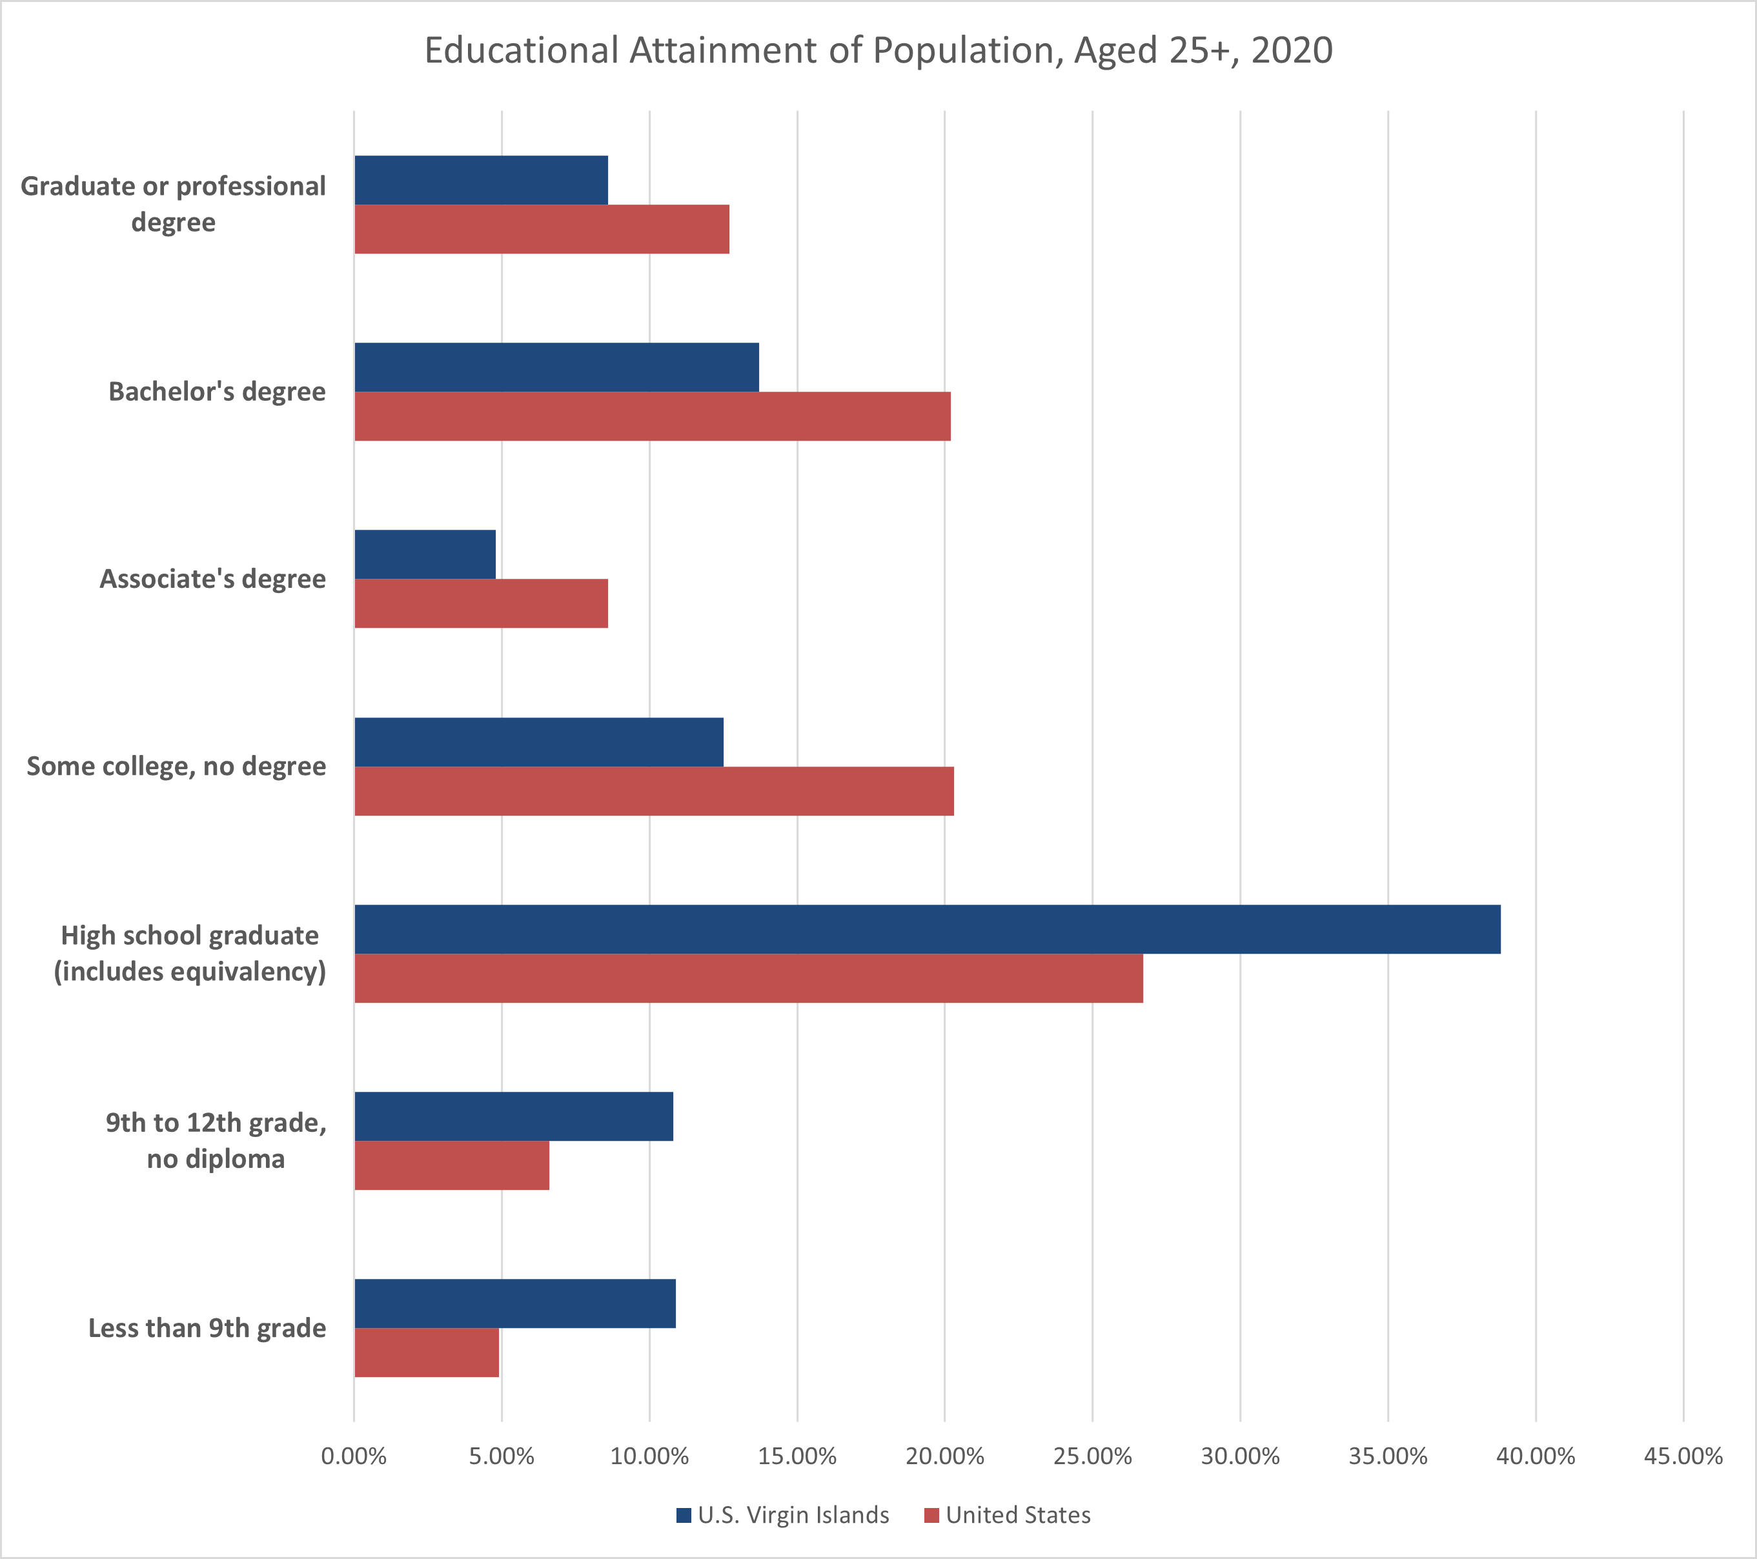
Education
One of the challenges facing the USVI’s workforce is the low educational attainment relative to the U.S. - the demand for higher education and skills will dominate employment opportunities in the economy. High-skill jobs are projected to be the fastest growing occupations over the next 10 years according to USBLS.
Notes:
Concerning education, one of the challenges facing the USVI’s workforce is the low educational attainment relative to the U.S. While nationwide, 30.1 percent of people age 25 and older had a bachelor’s degree or more, only 18 percent of USVI residents had a bachelor’s or higher. Nearly 26 percent of the population age 25 and higher had less than a high school diploma, twice as many nationally (Figure 7).
The USBLS 2020 to 2030 projections of which jobs will grow over the next decade have implications for people with a high school diploma or less. Job growth is about zero or negative for those without a college degree or a high school diploma. While most jobs in the USVI economy are low-skilled (those that require a high school diploma or less), it was the high-skill jobs that were projected to be the fastest occupations over the next 10 years.1 These results suggest that the demand for higher education and skills will dominate employment opportunities in the economy.

Slide 5
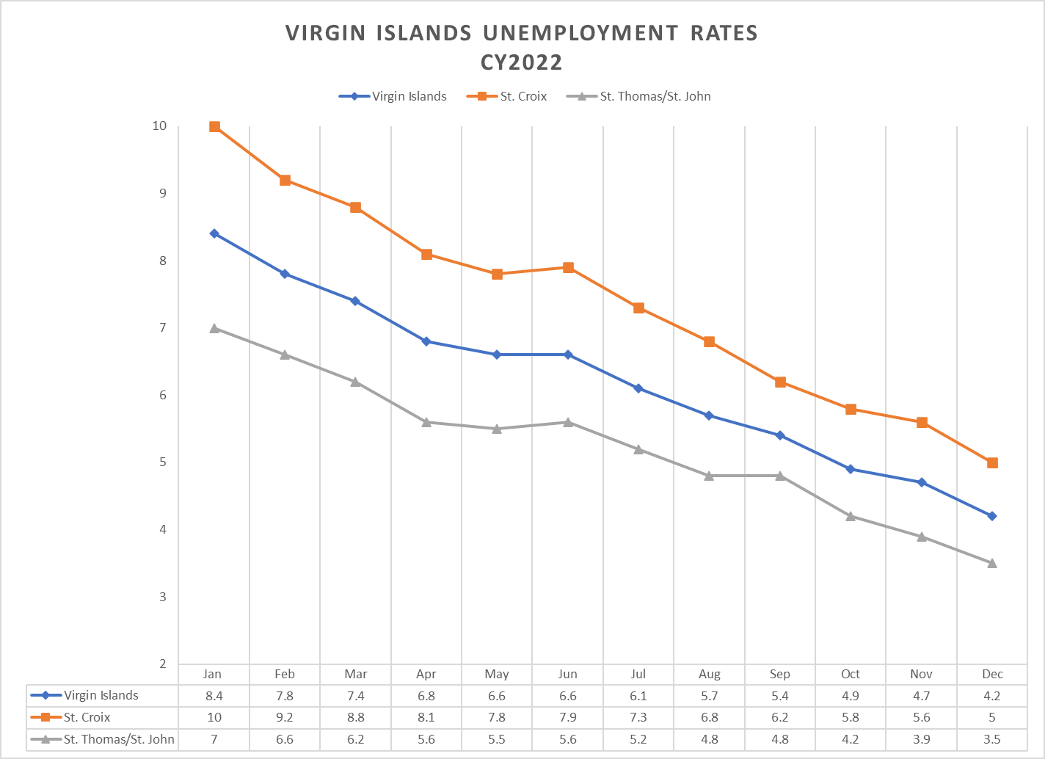
Unemployment Rates
The Unemployment Rates in all districts declined back to Pre- Pandemic levels.
At the end of 2022 rates were as low as 3.5% indicating that there were positive signs of employment opportunities in the Virgin Islands, and fewer individuals filing for benefits.
*Includes are all persons in the civilian noninstitutional population ages 16 and older classified as either employed or unemployed.

Slide 6
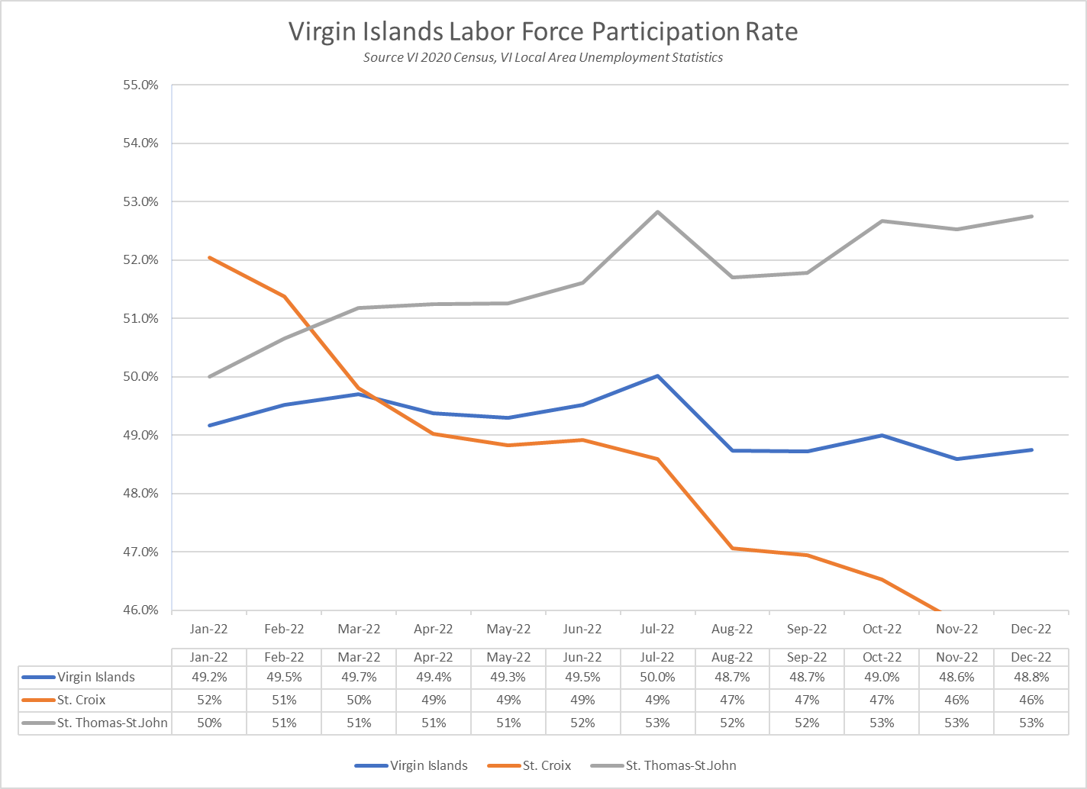
Labor Force Participation Rate
The participation rate is the percentage of the population that is either working or actively looking for work.
The labor force participation rate is calculated as: (Labor Force ÷ Civilian Noninstitutional Population) x 100.
The Virgin Islands Labor Force participation rate for Calendar Year 2022 averaged 49.2%, indicating that the economy is no longer contracting and reflecting signs that job demand is improving after the pandemic periods.

Slide 7

Where Are We Now?
Total Unemployment Insurance Claims Processed
As of March 6, 2023
1,395 active benefit year claims
(St. Thomas – 581 St. Croix – 562 Interstate – 151 and St. John – 101)

Slide 8

Workforce Development
Programs & Initiatives

Slide 9










THANK YOU TO THE TEAM!
OTHER PARTNERS & ENTITIES

Slide 10
Employment Services
Employment Services bring together individuals looking for employment and employers looking for job seekers. Workforce Development continue to build stronger and better relationships with employers throughout the territory, recognizing that employers drive workforce.
Webinars are conducted every four (4) to six (6) weeks as an avenue to keep business informed and engaged. Twelve (12) webinars were hosted, and we estimate over one hundred (100) different employers throughout the territory attended at least one of the webinars in 2022.
Career fairs and hiring events are hosted to assist employers with their recruitment needs. Three (3) career fairs and fourteen (10) hiring events were hosted during the calendar year 2022. One hundred and seventy-three (173) hires were resulted in our Virgin Islands Electronic Workforce System (VIeWS).

Slide 11
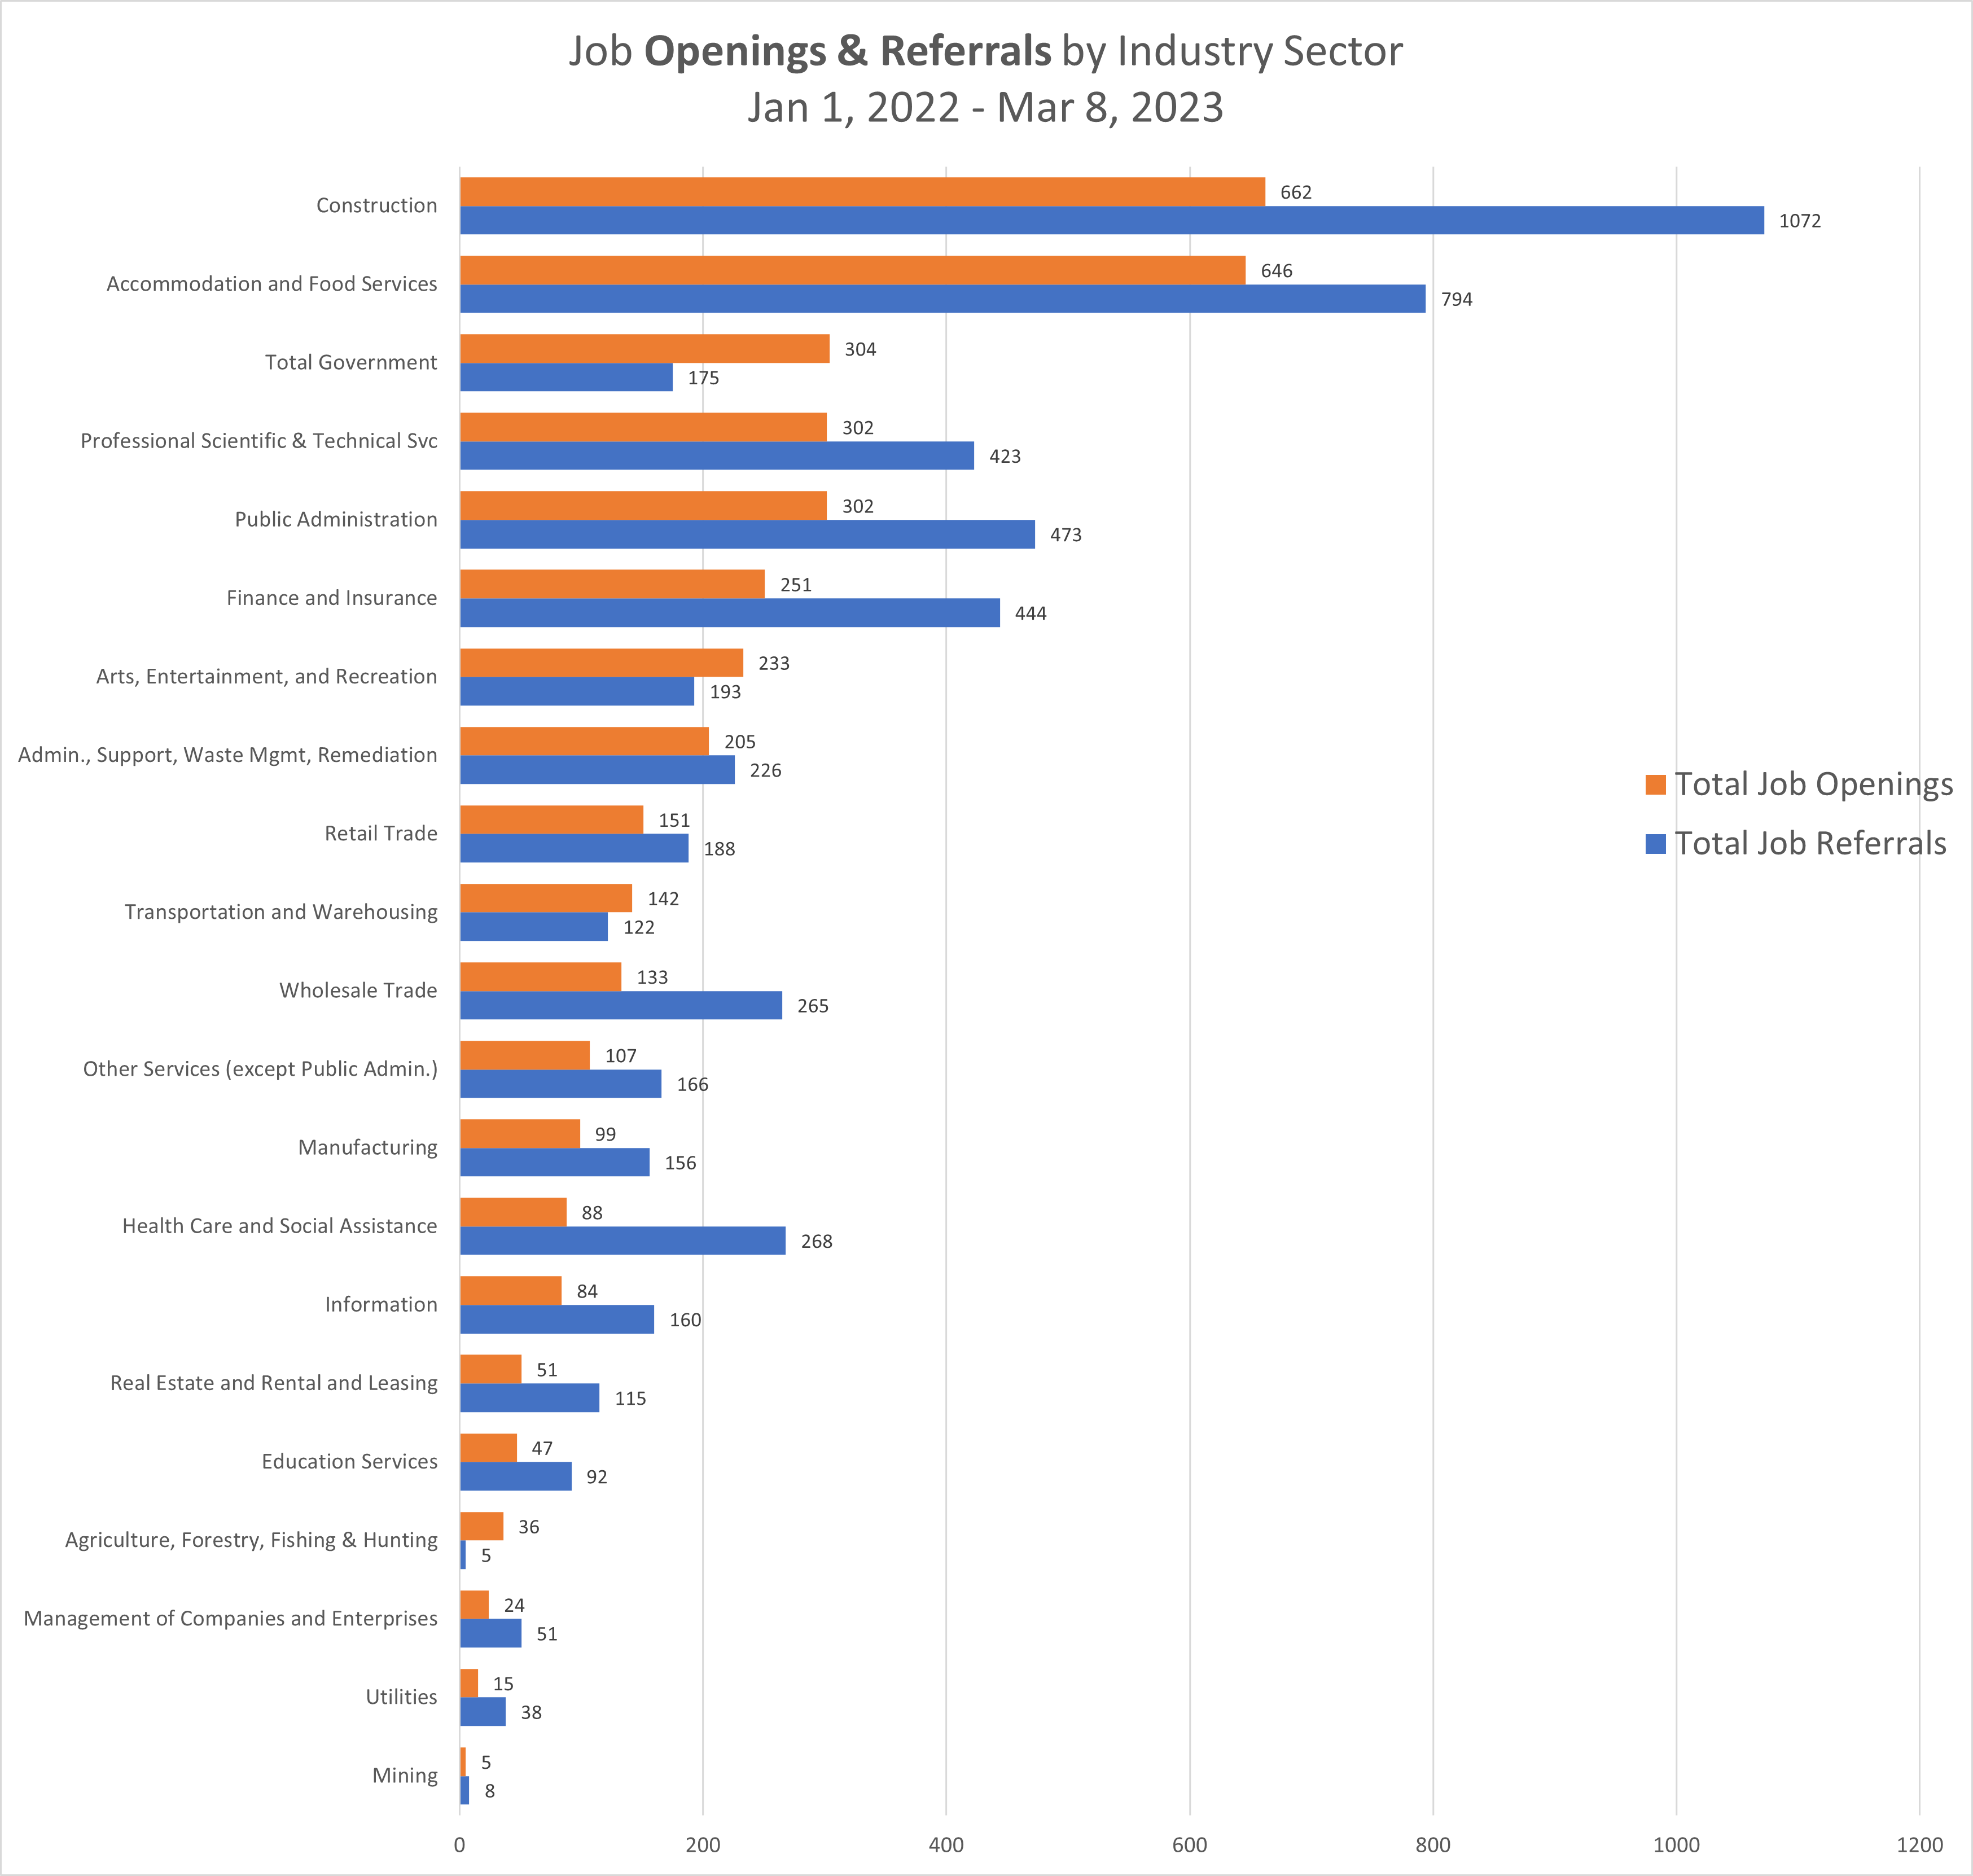
JOB OPENINGS AND REFERRALS BY INDUSTRY SECTOR

Slide 12
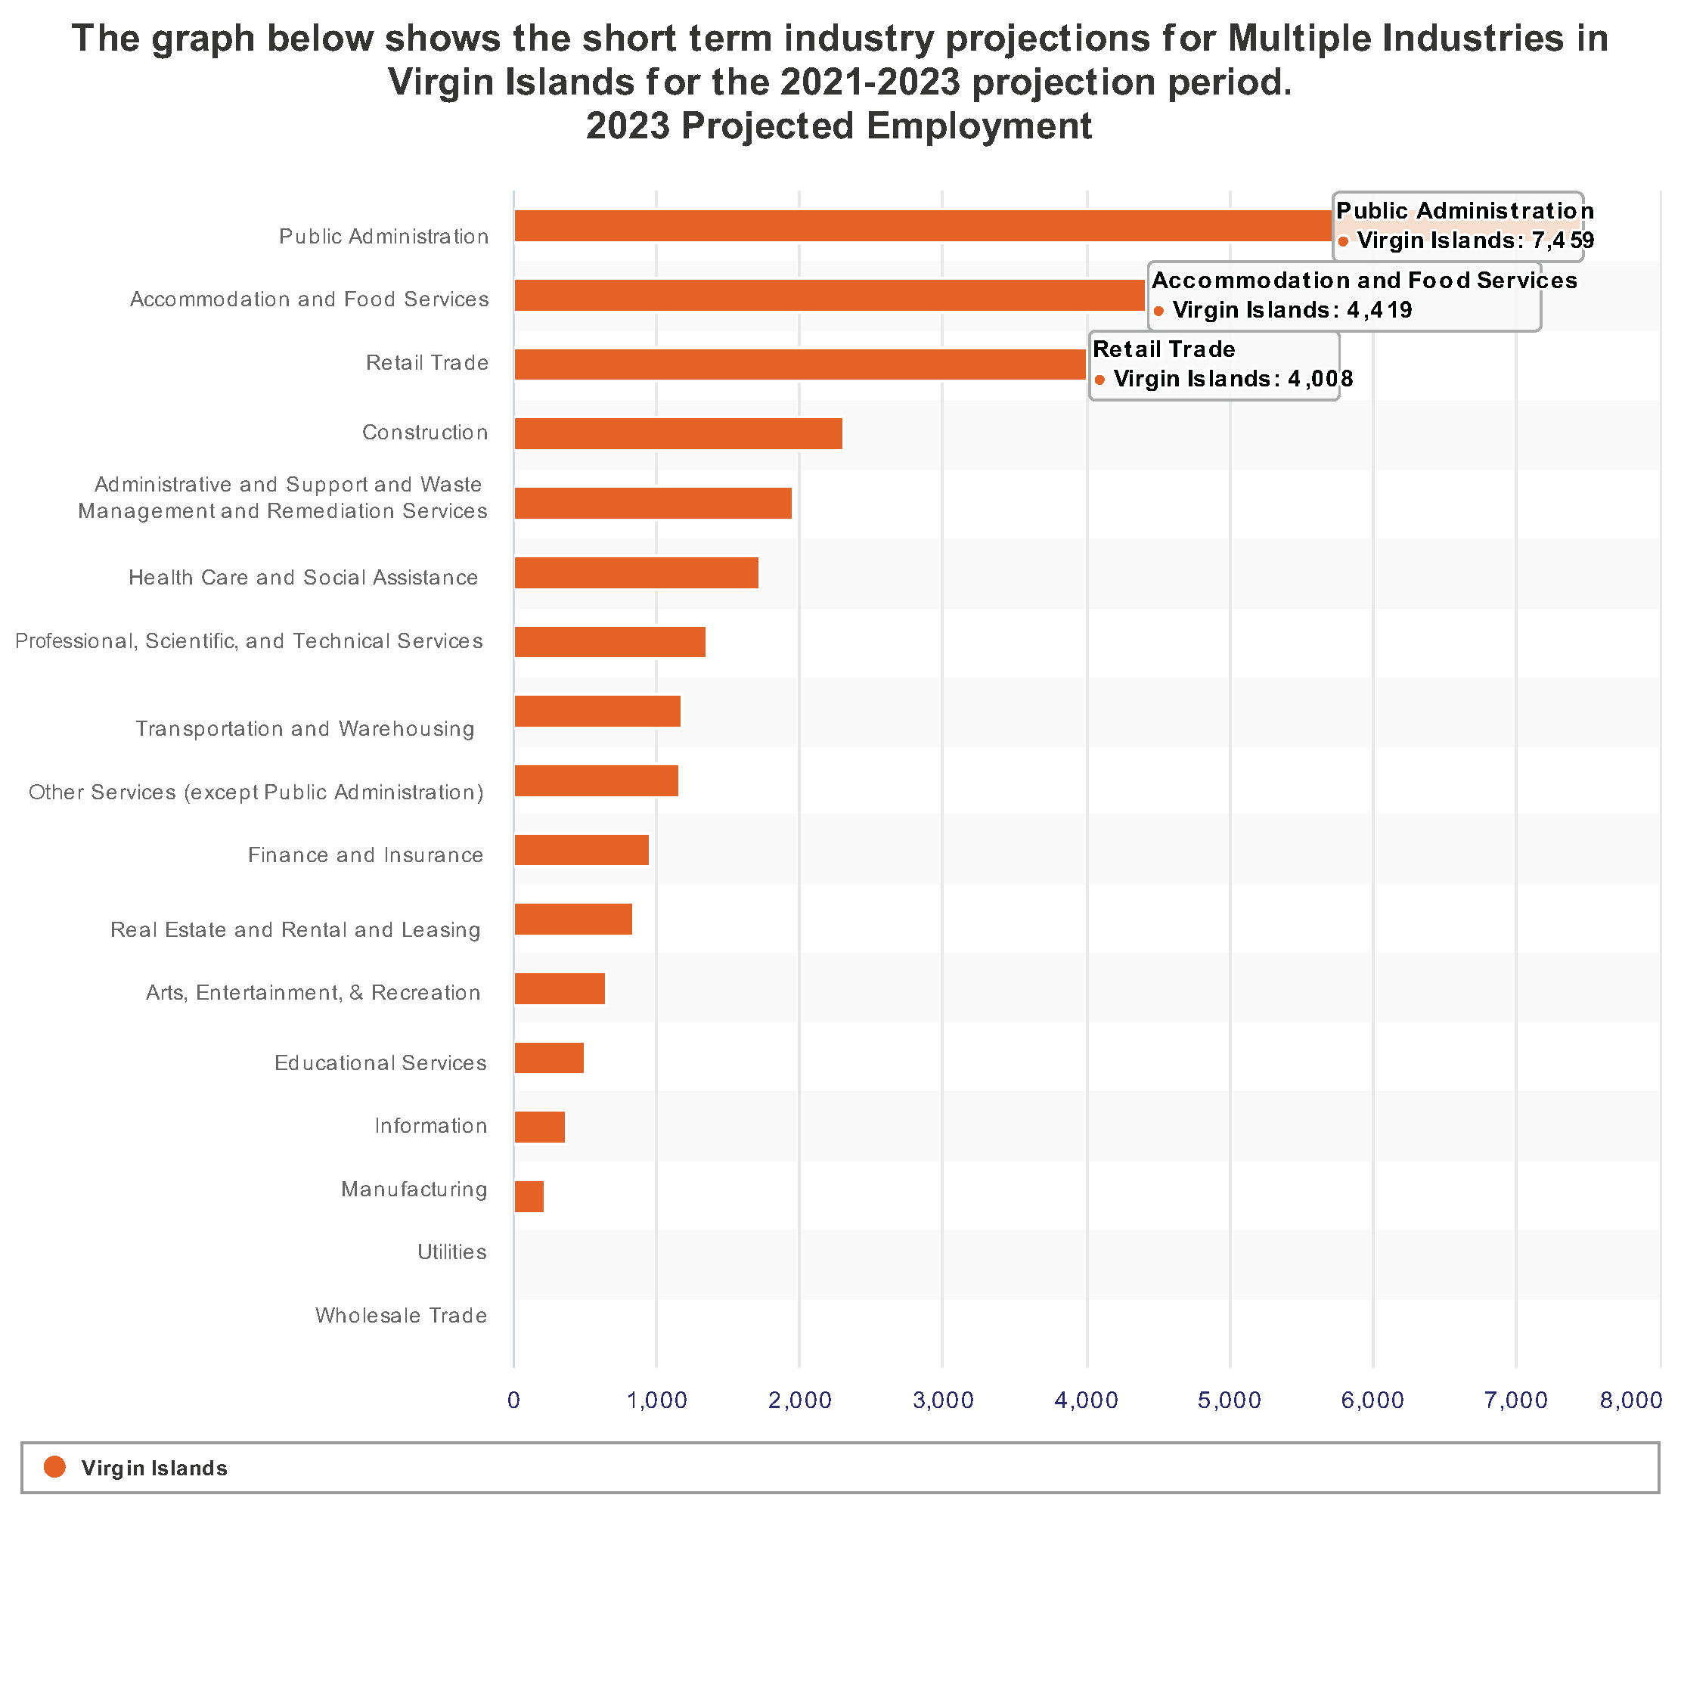
2023 USVI Projected Employment
Top 3 industries:
Public Administration
Accommodation and Food Service
Construction

Slide 13
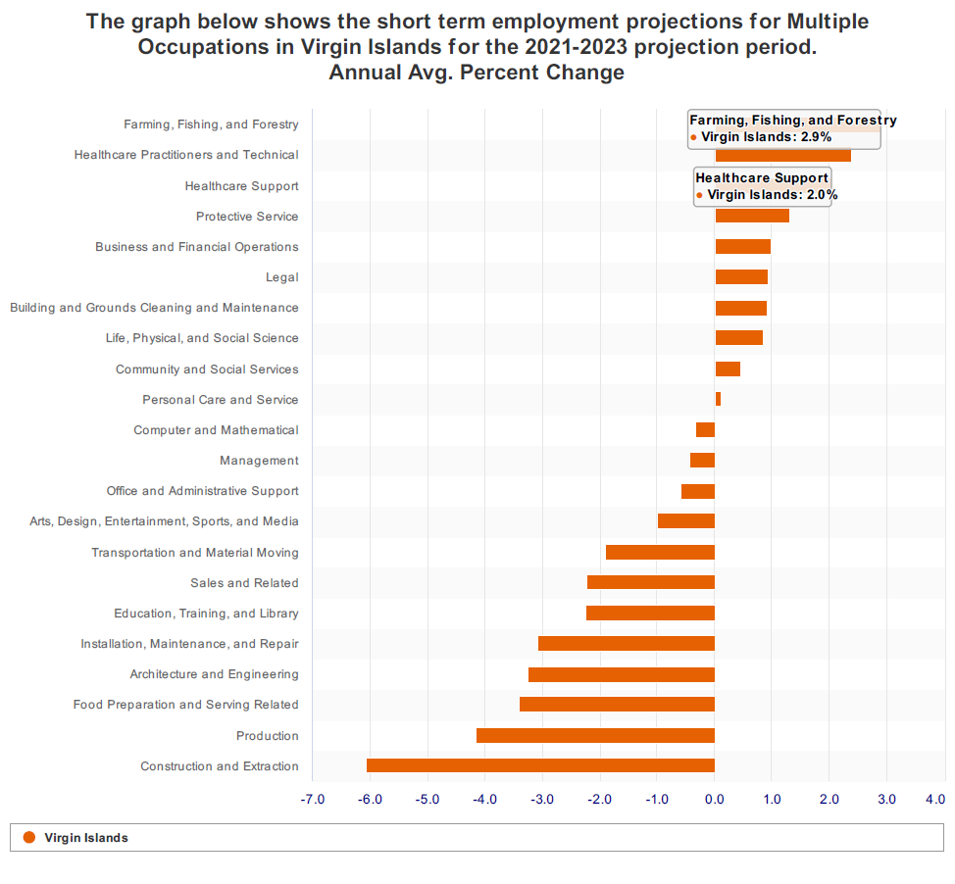
Short-term Occupational Outlook for USVI:
Demand:
Healthcare Practitioners & Tech.
Healthcare Support
Declining:
Food Prep. & Serving
Construction and Extraction

Slide 14
WIOA Training Program Enrollment Numbers- All ProgramsAll Programs
16 ETPL Approved Providers
Industry Sector
CY2022
Jan. 1 – Mar. 8, 2023
Healthcare/Allied Health
112
8
Construction Trades
36
2
Administrative & Support Services
1
4
Information Technology
1
0
Leisure & Hospitality
17
1
Total
169
18

Slide 15
WIOA Occupational Skills Training Programs -FEDERAL FUNDING
Administrative and Support Services
Administrative Assistant
Healthcare Support/Allied Health
Behavior Technician and the Medical Office Cardi-Phlebotomy Technician Certified Massage Therapist Certified Nursing Assistant
Child Care with CDA Certification Child Day Care Management
Clinical Medical Assistant Electronic Health Records and Reimbursement Specialist
Emergency Medical Technician
Licensed Practical Nurse Medical Administrative Assistant Medical Assistant Medical Billing Specialist
Medical Front Office Assistant and Administration Specialist
Medical Front Office and Electronic Health Records
Phlebotomy Technician Physical Therapy Aide and Administration Specialist
Construction Trades
Carpentry
Electrical Technician
Certified Fiber Optics Technician Refrigeration(HVAC)
NCCER Core Curriculum
NCCER Electrical I
Welding
Information Technology
Leisure & Hospitality
Culinary Arts Culinary – Certified Fundamentals Cook

Slide 16









REGISTERED APPRENTICESHIP PROGRAMS IN THE Virgin Islands
Forty-six (46) registered apprentices
Eight (8) Sponsors with at least one RA
Occupations:
Massage Therapist
Medical Assistant/Patient Care Coordinator
Surgical Technologist
Life Safety Coordinator
Boat Building
Marine Services Technician
Able Seaman (water transportation)
Pipefitter (construction)
Cook
Recreation
More on the Way!!
Gold Coast Yachts
As of 11.15.22

Slide 17
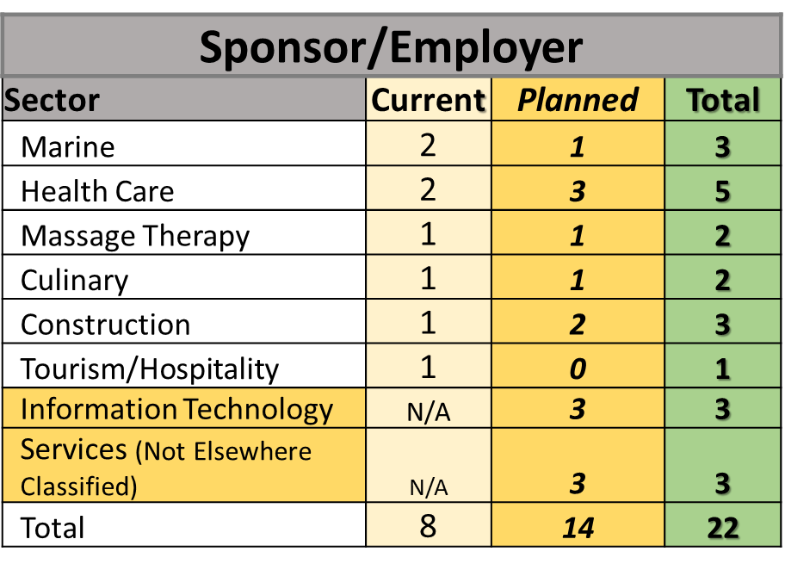
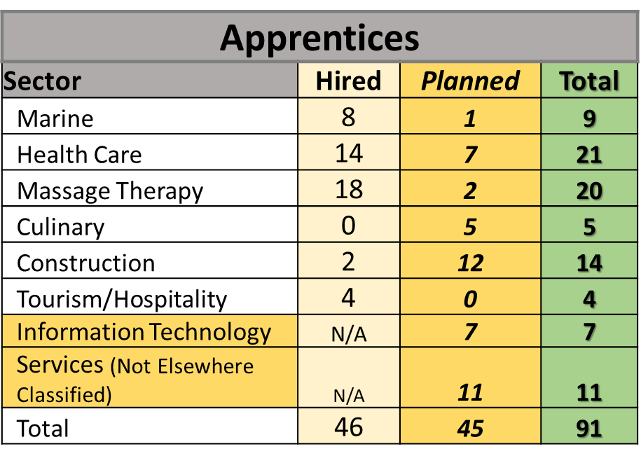
Projection for the next 6 months to 1 year

Slide 18
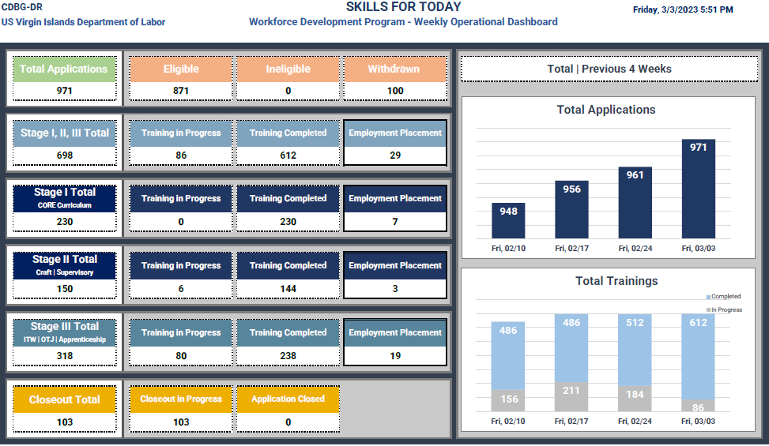
SKILLS FOR TODAY WEEKLY OPERATIONAL DASHBOARD

Slide 19
THANK YOU TO THE TEAM!
OTHER PARTNERS & ENTITIES

Slide 20

Questions?

