Slide 1
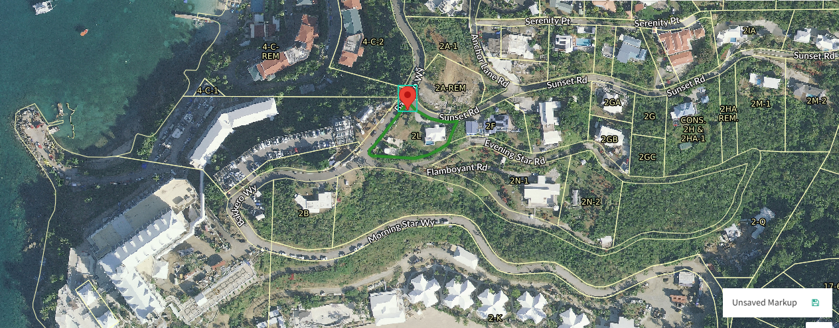
CCZP0001-25: MapGeo aerial view of property (marked in red)

Slide 2
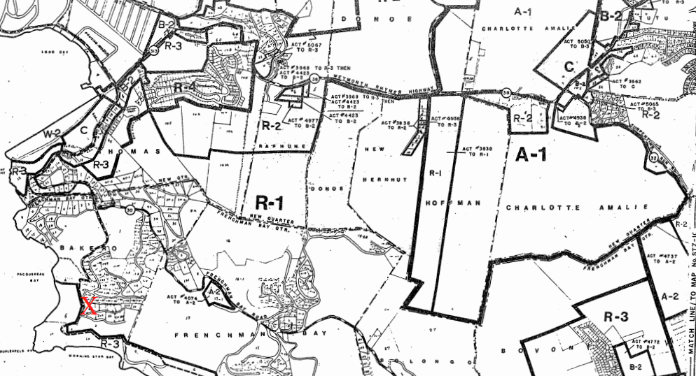
CCZP0001-25: Official Zoning Map No. STZ-7 (property location indicated by red X)

Slide 3
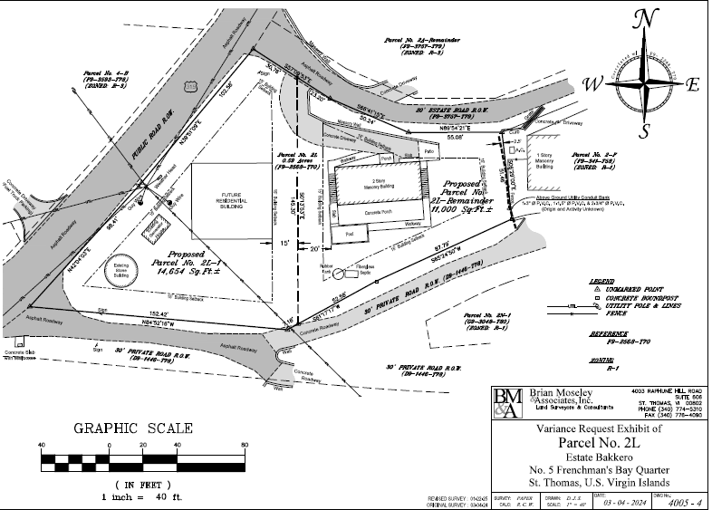
CCZP0001-25: Conceptual Site Plan Layout

