Slide 1
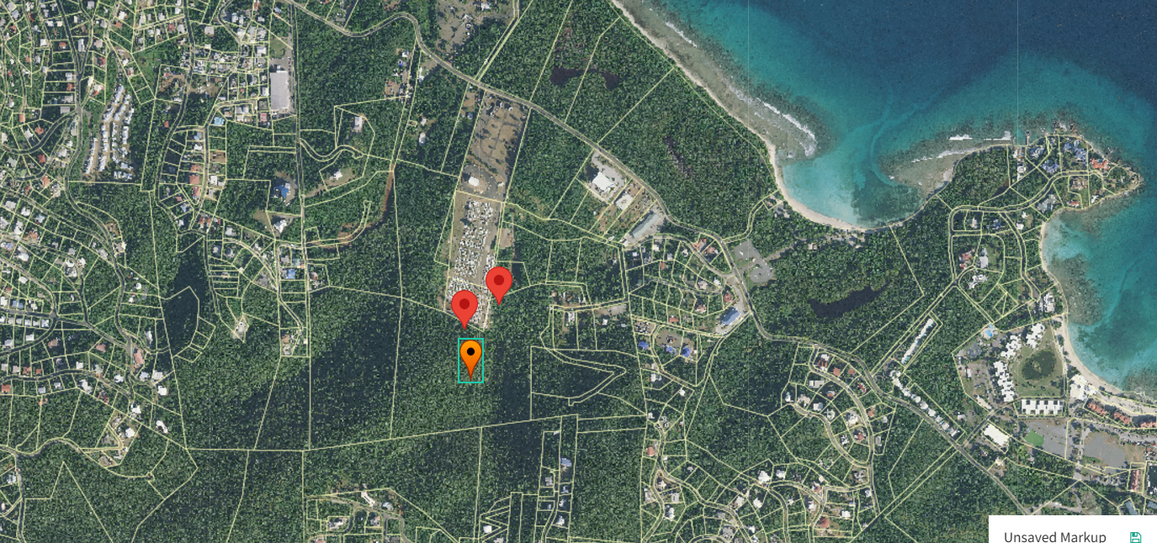
CCZP0153-24: Photo of current site condition- undeveloped land (red/orange dots)

Slide 2
CCZP0153-24: MapGeo aerial view of properties (marked in red)

Slide 3
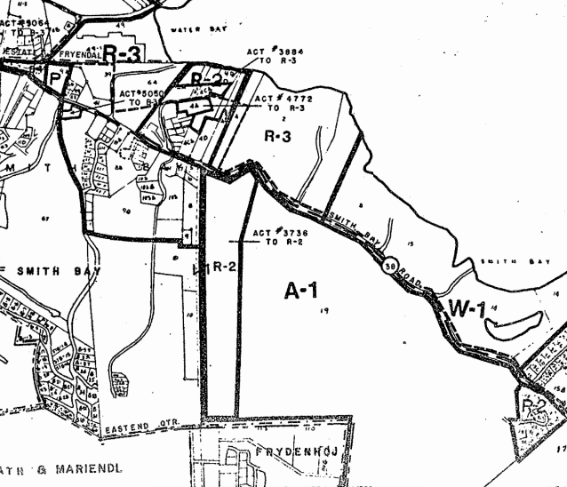

CCZP0153-24: Official Zoning Map No. STZ-9 (properties’ location indicated by red X

Slide 4
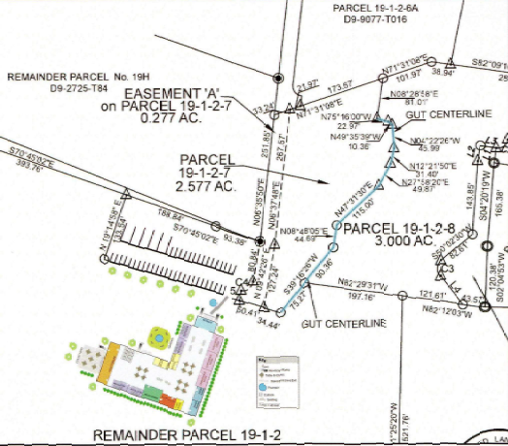
CCZP0153-24: Conceptual Site Plan Layout

