Slide 1



Virgin Islands
Department of Human Services
Office of Child Care
& Regulatory Services
Provider Requirement Guide
January 29, 2021
Good Standing
Licenses
Inspections
Vouchers
W-9 Forms
Sam.gov
Application
Agreement

Slide 2
Informal Providers also called
Family, Friends and Neighbors (FFN)

Slide 3
Informal Provider/Family, Friends and Neighbors (FFN)
Licensing Approval Checklist
Completed Applications
  Completed Parent Application
  Completed Provider Application
VIPD –Police Record Check - by provider
Sex Offender Check – by Office of Child Care & Regulatory Services
Child Abuse Registry Check – by Office of Child Care & Regulatory Services
Virtual/Phone Interview
Provide pictures of the home
W-9 Form
Completed Provider Agreement - (Office of Child Care will notify Provider of approved Agreement)
Notes:
Where to get application? Where and how to submit application? To whom?

Slide 4
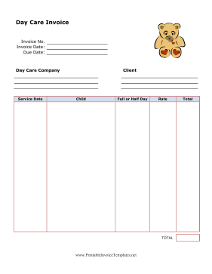
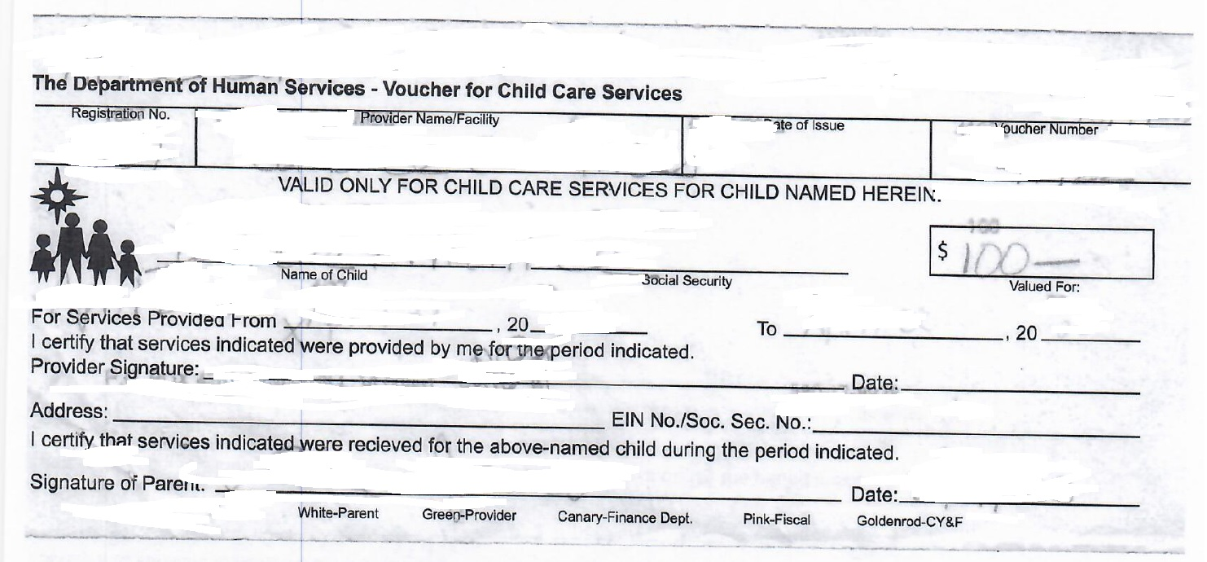
PAYMENT PROCESSING REQUIREMENTS
INVOICE(S): The invoice must include
an unduplicated invoice number
official name of the provider (business name on W-9)
mailing address (MUST MATCH ADDRESS ON W-9)
phone number
name of the child(ren) services were provided for during the month
total number of children included on invoice
total dollar amount of charges on the invoice
provider signature
Provider Agreement
Completed ACH document/blank check
Vouchers
  must be signed and dated by both client and provider, and must not exceed the 90 days of the valued period.
Monthly Invoices

Slide 5
PAYMENT PROCESSING REQUIREMENTS CONTINUED
SUBMIT VOUCHERS AND INVOICES MONTHLY
BY THE 5TH OF THE FOLLOWING MONTH

Slide 6
Formal Providers also called
Child Care Providers

Slide 7
Child Care Provider Subsidy Required Documents
Completed Provider Agreement
Department of Human Services License (s)
Health Inspection Certificate –Current
Fire Inspection Certificate – Current
SAM.GOV Registration – Current
Letter of Good Standing
Updated Rate Sheet
W-9 Form – Completed
Operational Schedule or School Calendar
School/Student Accident Insurance

Slide 8
PAYMENT PROCESSING REQUIREMENTS
ATTENDANCE CERTIFICATE(S): The attendance certificate must list the provider, the period of services, the name of the children, the child (ren) date of birth, provider signature and tax identification number or social security number.
INVOICE(S): The invoice must include
an unduplicated invoice number
Official name of the provider (business name on W-9)
mailing address (MUST MATCH ADDRESS ON W-9)
phone number
name of the child (ren) services were provided for during the month
total number of children included on the invoice
total dollar amount of charges on the invoice
provider signature
VOUCHER(S): The vouchers must be signed and dated by both client and provider and must not exceed the 90 days of the valued period.

Slide 9
CHILD CARE PROVIDERS IMPORTANT REMINDERS
Please submit monthly voucher(s), invoice(s) and attendance certificates to allow monthly subsidies to be processed.
Monthly vouchers along with an invoice(s) and attendance certificate(s) must be submitted together, to the Office of Child Care and Regulatory Services no later than the 5th day of the month following the month of services.
Payments for services rendered may be delayed or jeopardized if invoices, vouchers or attendance records are inaccurate or if they are submitted after the 5th day of the month following the month of services.
Payment for services will be based on actual attendance of the approved child(ren) named.
Notes:
Documents are to be submitted to whom?

Slide 10
Child Care Providers Reminders continued…
Payment packages submitted in excess of twelve (12) months after the month of services, will not be processed.
Child care costs that exceed the subsidized amount, is the responsibility of the parent(s), to be paid by the parent(s) to the Provider.
Parent(s) will be responsible for the established co-payment.

Slide 11

If you have questions, please contact any of our Office of Child Care and Regulatory Services locations:
on St. Croix at #129 Golden Rock, Christiansted,
telephone number (340)772-7147
or on St. Thomas at the Knud Hansen Complex
at 1303 Hospital Ground
at telephone number (340)774-0930 ext.4182 or ext. 4185
or on St. John at the DHS Cruz Bay office
at telephone number (340)774-0930 ext.4182 or ext. 4185

