Slide 1
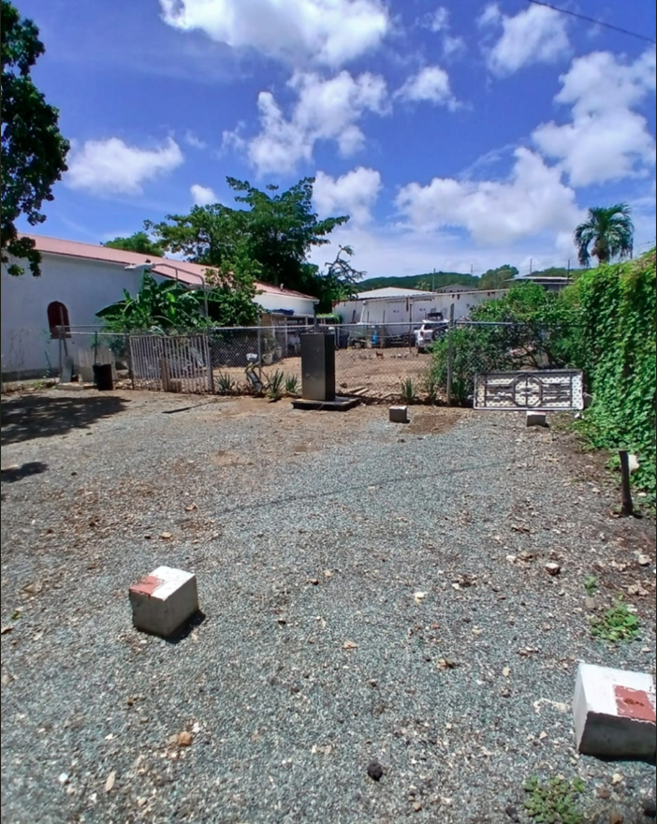
CCZP0066-25:Photo of current site condition

Slide 2
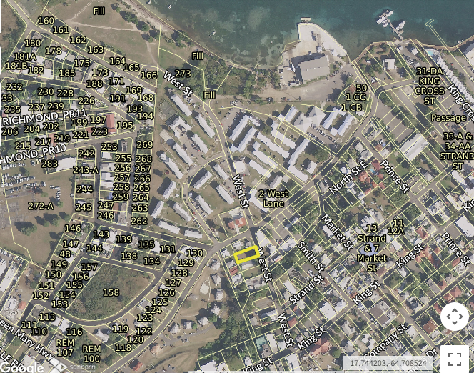
CCZP0066-25: MapGeo aerial view of property (marked in red)

Slide 3
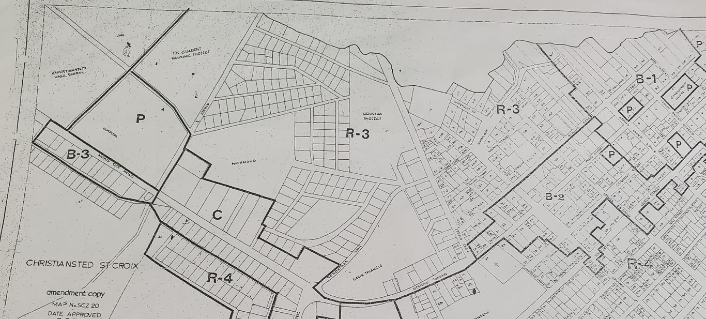

CCZP0066-25: Official Zoning Map No. SCZ-20 (property location indicated by red X)

Slide 4
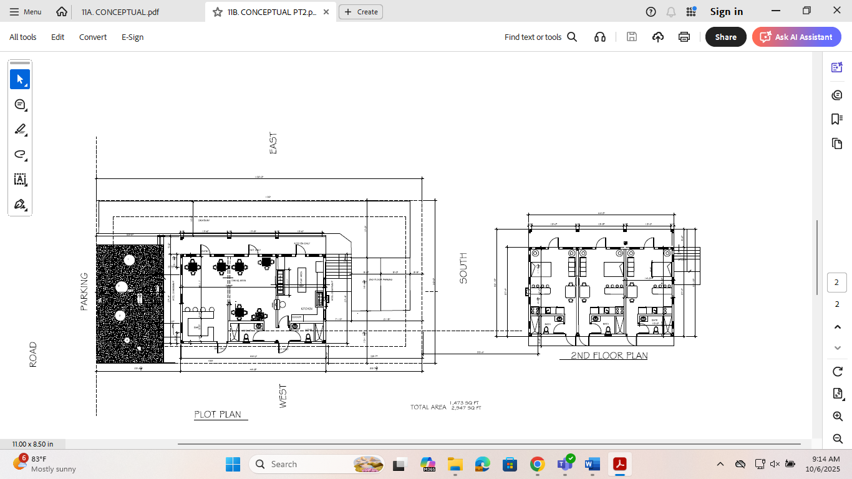
CCZP0066-25: Conceptual Site Plan Layout

