Slide 1
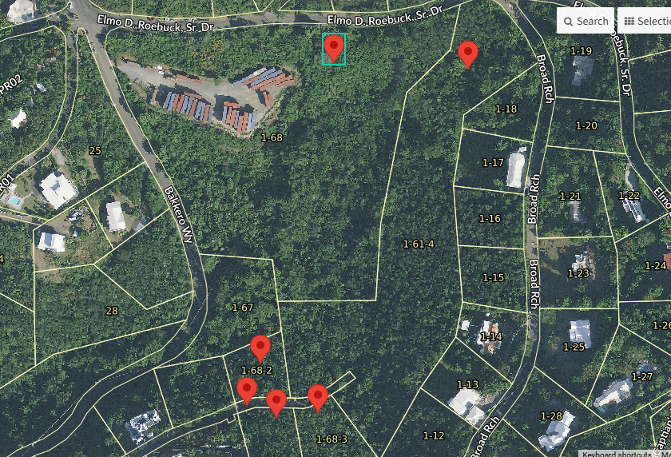
CCZP0091-25: MapGeo aerial photo of the six properties (marked in red)

Slide 2
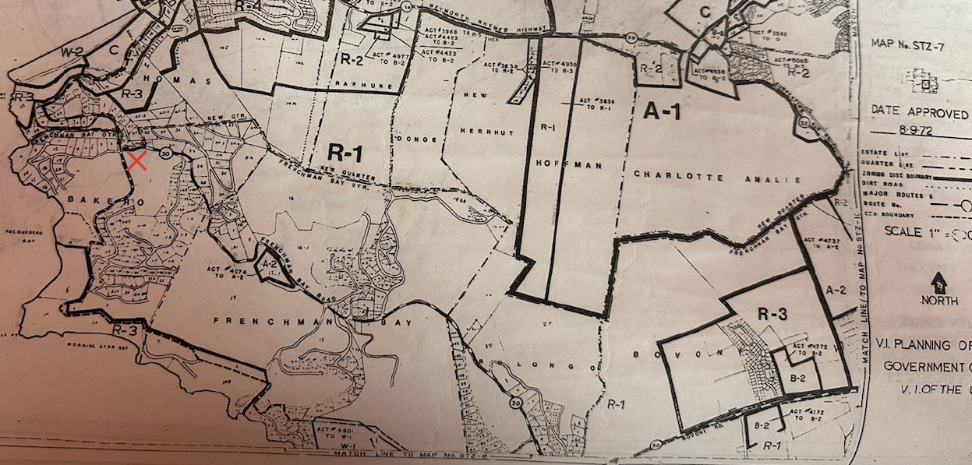
CCZP0118-25: Official Zoning Map No. STZ-7 (properties marked with red X)

Slide 3
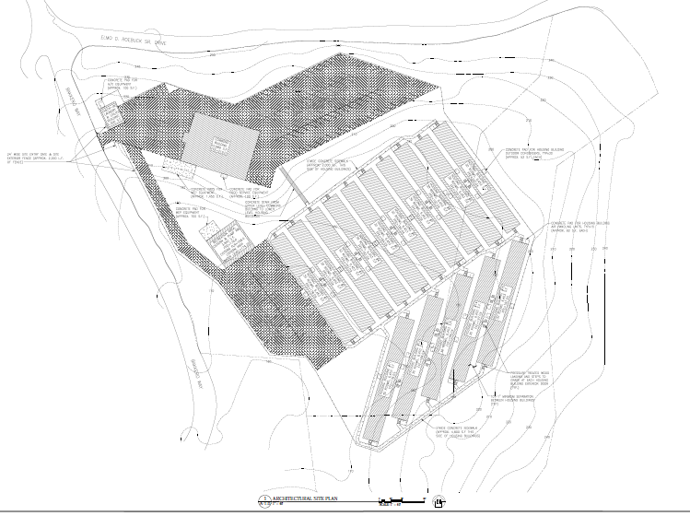
CCZP0091-25: Conceptual Site Plan Layout

