Slide 1
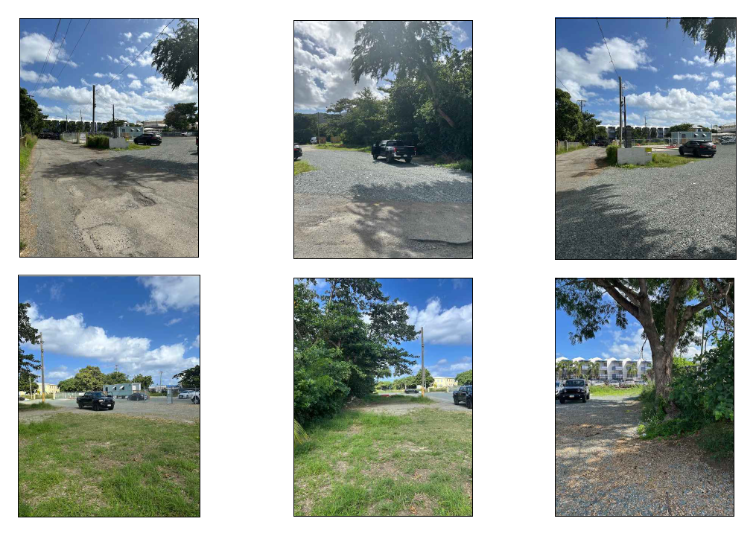
CCZP0038-25:Photos of site condition- Accessory car rental operation for the Hotel Caravelle

Slide 2
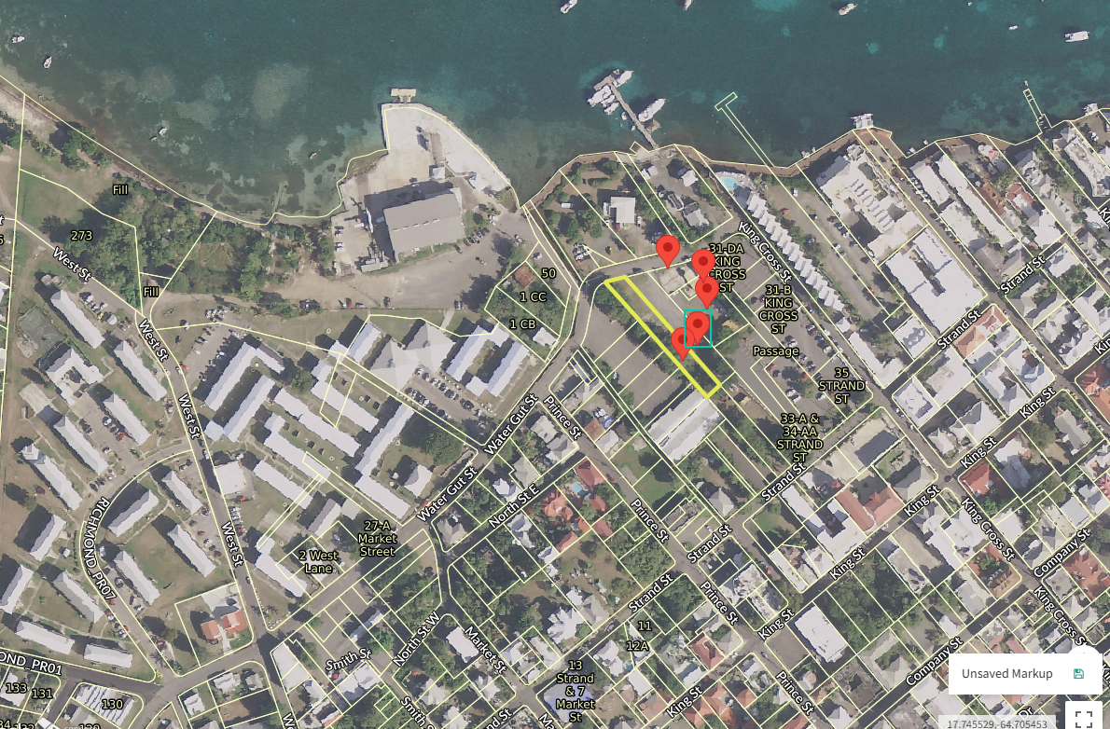
CCZP0038-25: MapGeo aerial view of properties (marked in red)

Slide 3
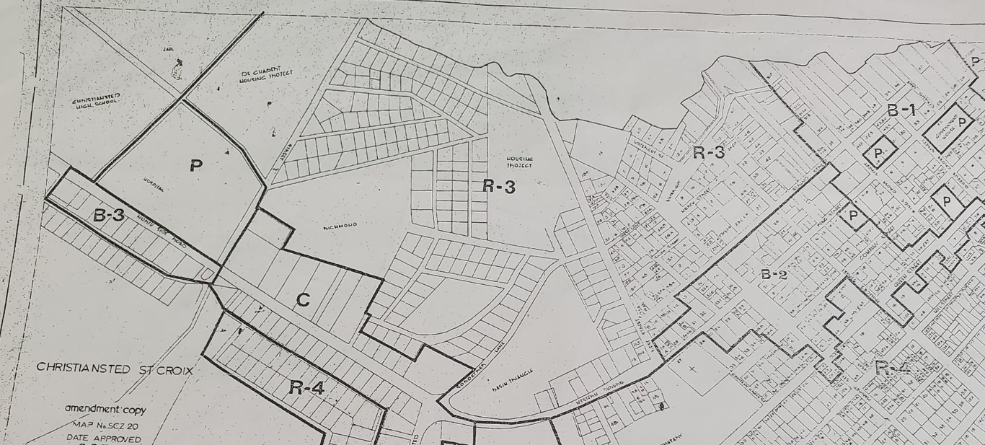

CCZP0038-25: Official Zoning Map No. SCZ-20 (property location indicated by red X)

Slide 4
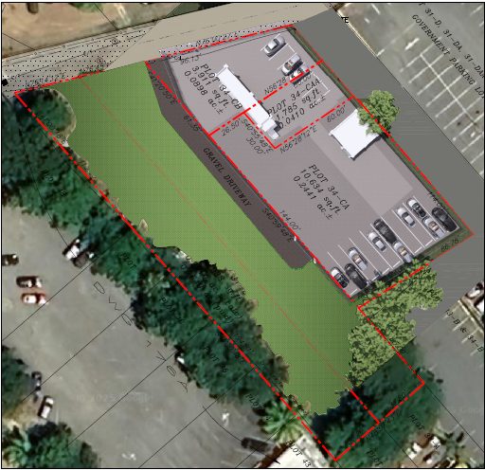
CCZP0038-25: Conceptual Site Plan Layout

