Slide 1
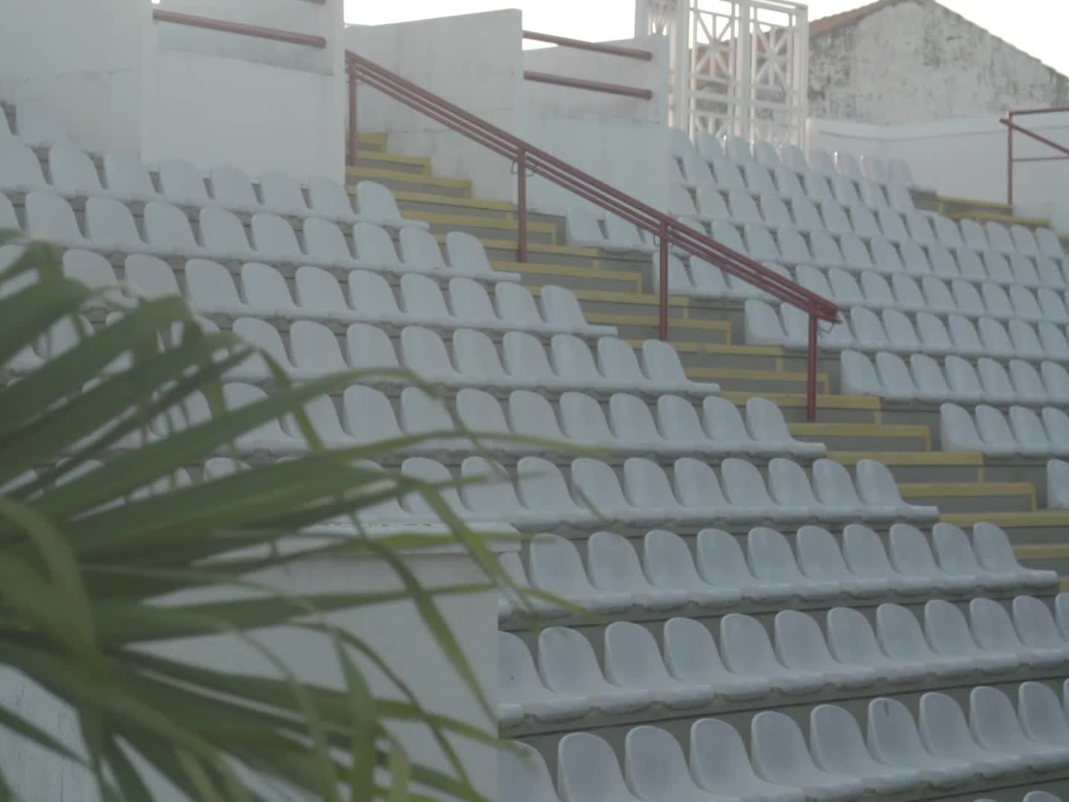
Paul E. Joseph Stadium Hearing
Prepared by Senator Bolques – CYASP Committee | July 18, 2025

Slide 2
Paul E. Joseph Stadium Project Timeline
2014
Initial contract awarded to GEC, LLC for over $20 million.
2015
Partial demolition completed.
Change Order #1 issued, adding 316 days to the project.
2016–2020
No field activity during this period.
Coastal Systems supported planning and backend work.
Change Orders #8 (Oct 2019) and #13 (Dec 2020) added a total of 717 days and $2.9 million.
2023
Multiple 'time only' Change Orders (Nos. #16–#20) added 629 days.
No liquidated damages were enforced during this period. (2014 thru 2023)
2024–2025
Supplemental Contract No. 2 issued (Sept 2024) for $5.124 million with 288 days added.
Target completion date: June 28, 2025.
May 2025
60.2% of the project reportedly complete.
Several key components (elevator, restrooms, site prep) remain unfinished.
78% of project funds have already been paid.
Note: Between 2015 and 2024, over 10 Change Orders added 1,662 days (4.5 years) to the project. Liquidated damages were not enforced, and over $750,000 was paid beyond physical progress. Multiple contracts were issued before prior scopes were completed, revealing critical failures in oversight and accountability.

Slide 3
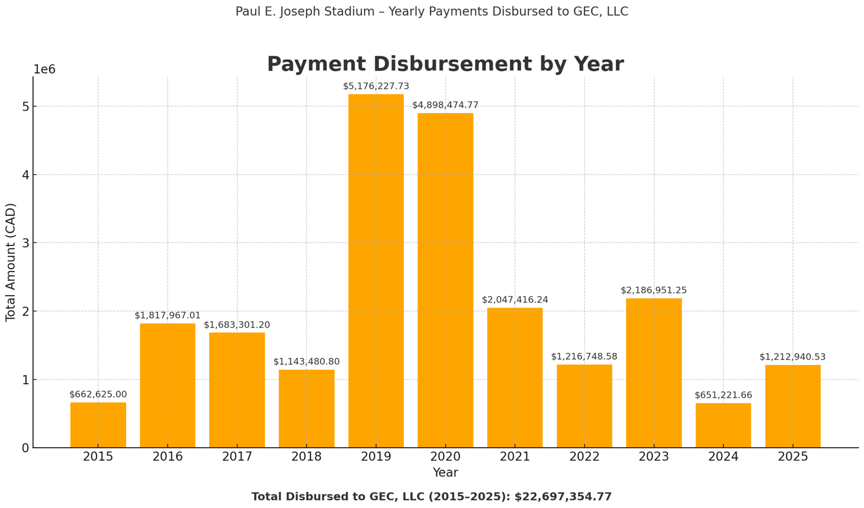
Payment Disbursement by Year

Slide 4
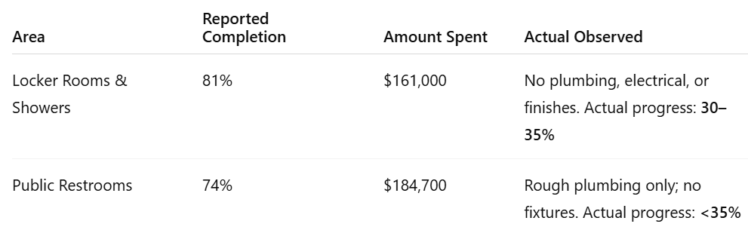
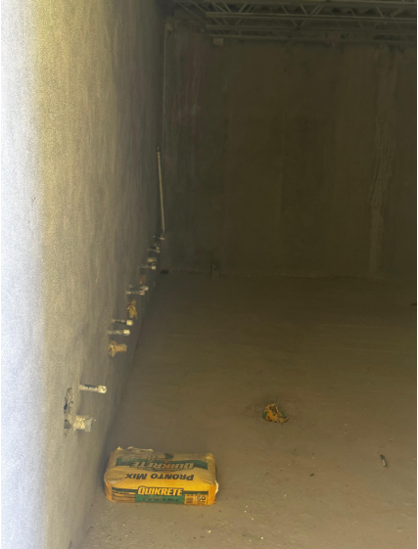
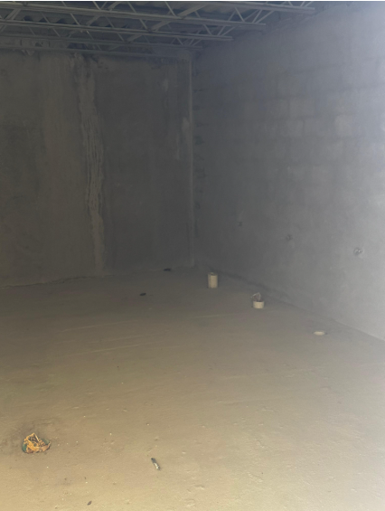
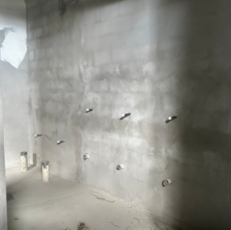
Summary
Combined expenditure: $345,700
Both areas remain non-functional and materially incomplete
Reported progress significantly overstates actual site readiness
Findings suggest potential oversight or misreporting of construction status

Slide 5
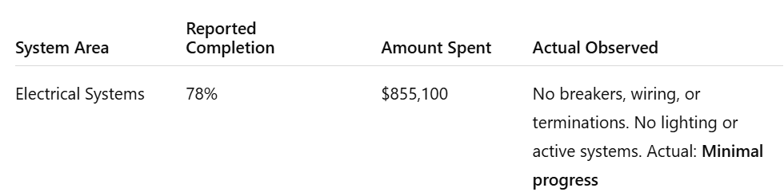
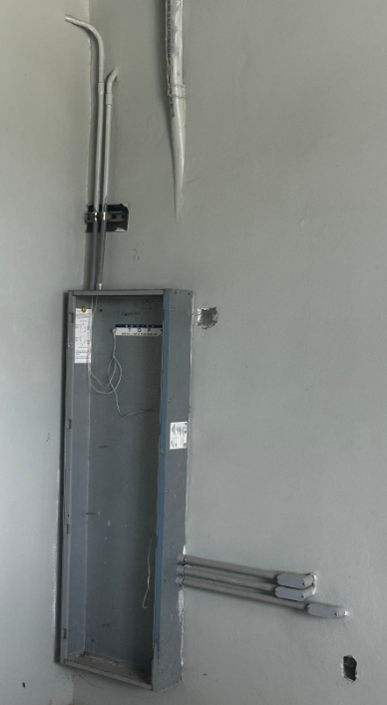
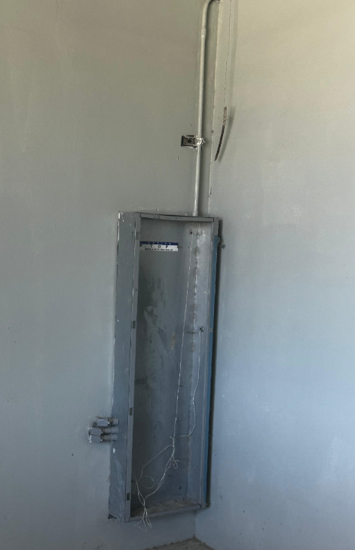
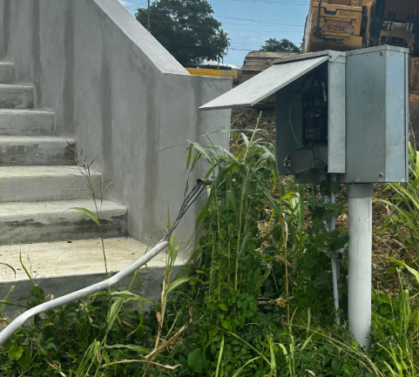
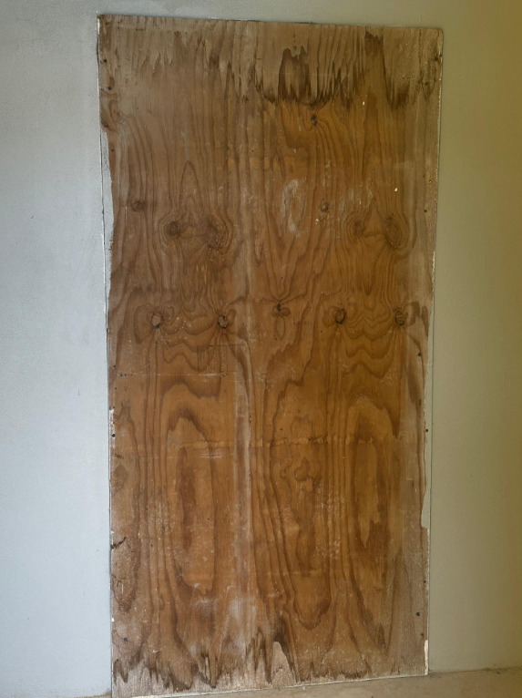
Summary
Total reported expenditure: $855,100
No operational electrical infrastructure observed
Basic installation steps incomplete across all inspected areas
Reported 78% completion is not supported by on-site conditions

Slide 6
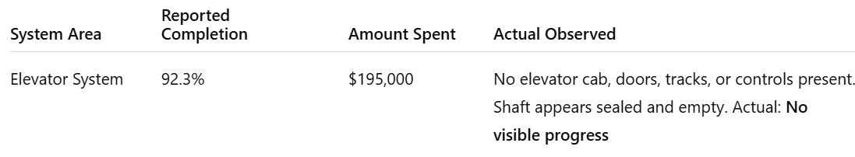
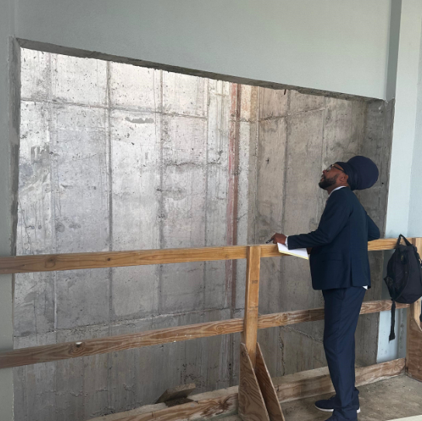
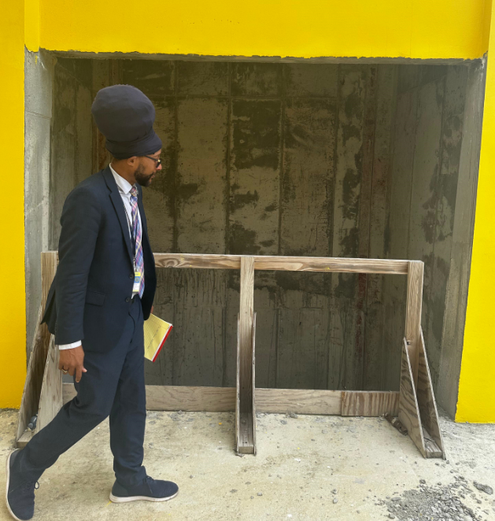
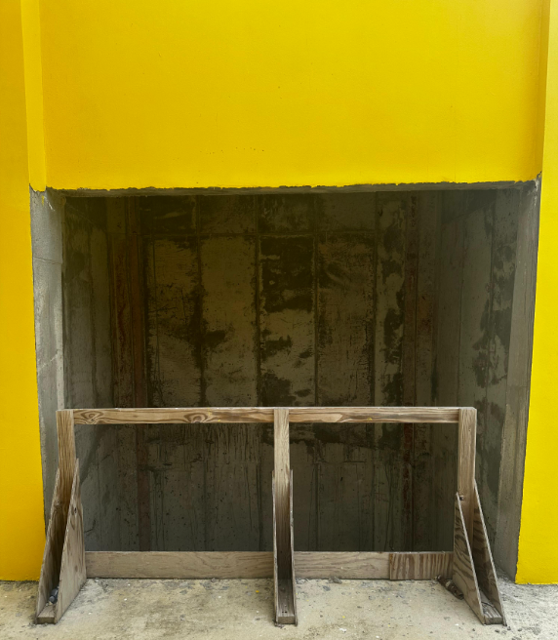
Summary
Reported value: $195,000
No elevator equipment or components present on site
No structural, mechanical, or electrical systems installed
Elevator shaft appears incomplete and sealed
Reported 92.3% completion not supported by observed conditions

Slide 7
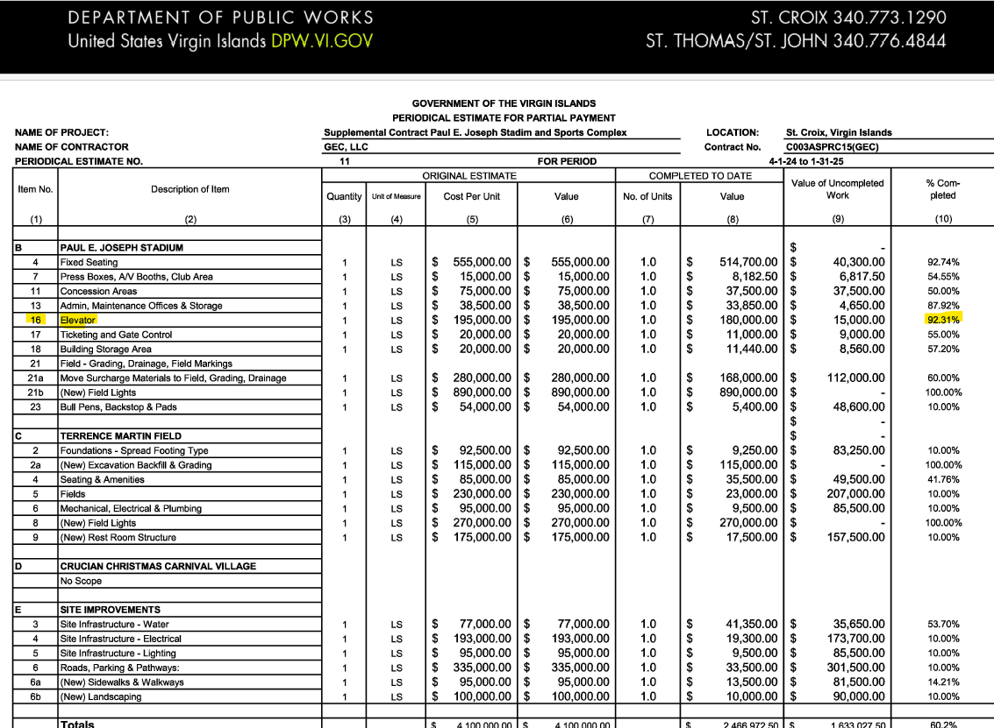
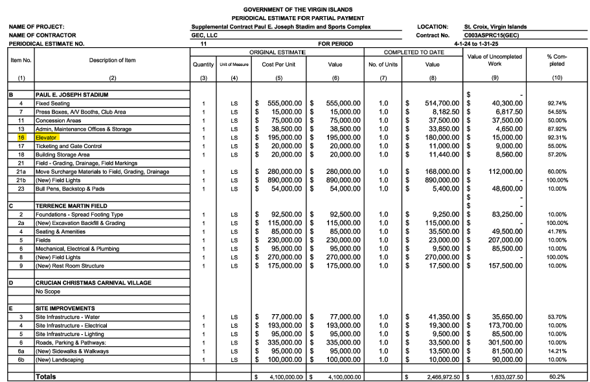

Slide 8
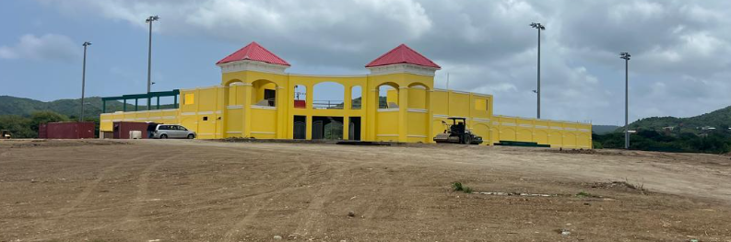
What $32.3 Million Bought Us in 11 Years
Photo taken July 2, 2025
Total Allocated: $32.3M
2020 Re-appropriation: $8.2M
2024 Supplemental: $4.1M
Reported Completion: 60.2%
Elevator Completion Claim: 92.3%

Slide 9
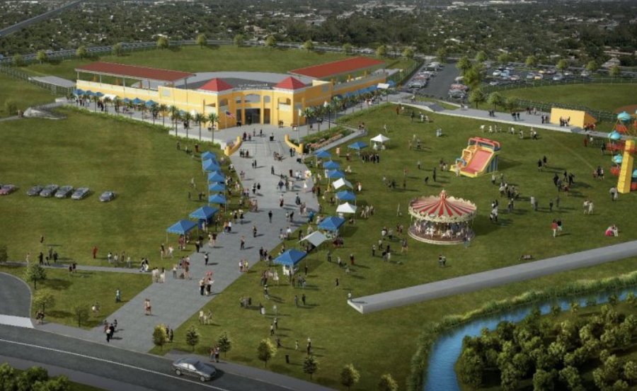
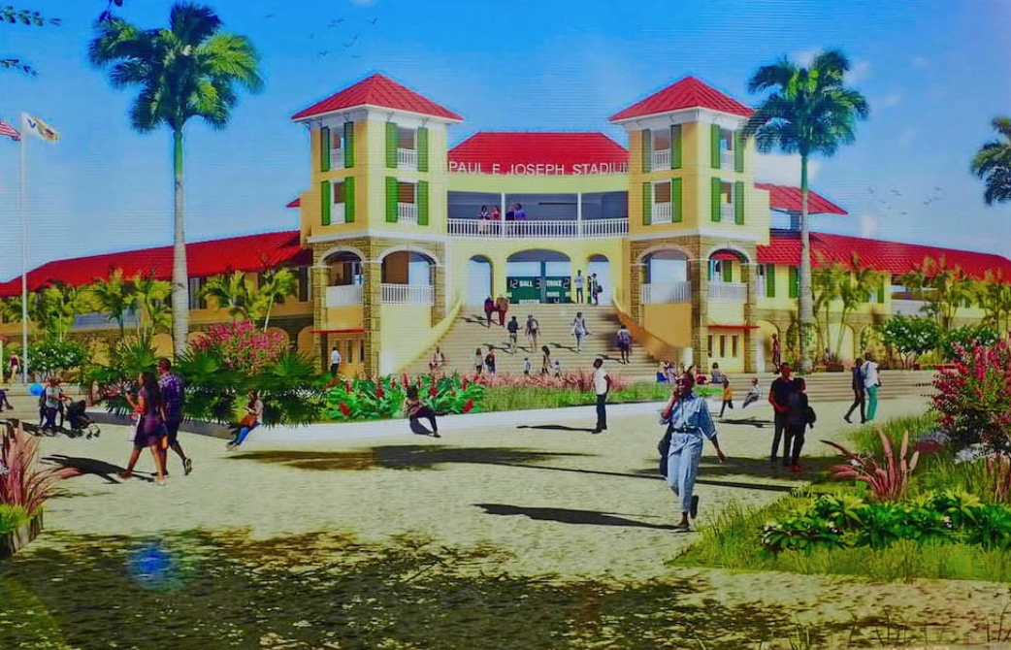
What $32 Million Should Look Like
Installed elevator with operational cab (as claimed to be 92% complete)
Fully constructed and roofed bleacher sections with seating
Restrooms with plumbing, fixtures, and lighting
Turf-ready field with drainage and base preparation
Operational Carnival Village venue with solar power, lighting, and finishes

Slide 10
Public Funds Deserve Public Accountability
It’s time for answers, documentation, and a renewed commitment to the people of the Virgin Islands.
Eleven years ago, the people of St. Croix were promised more than a stadium. We were promised a symbol of hope. A place to uplift our youth, honor our elders, and ignite pride across our island.
What we have instead is a half-finished shell. A monument to broken promises, mismanagement, and political neglect.
$32.3 million later, and despite over 20 change orders, this project is still not complete. These change orders added more than 1,662 days, that’s 4.5 years of delay, and over $8 million in additional costs, including a $5.1 million supplemental contract in 2024. And while the people waited, no liquidated damages were enforced, and over $750,000 was paid beyond the physical progress.
Today, 78% of the funds have been spent, yet key components like elevators, restrooms, and site prep remain unfinished.

